Slide 2
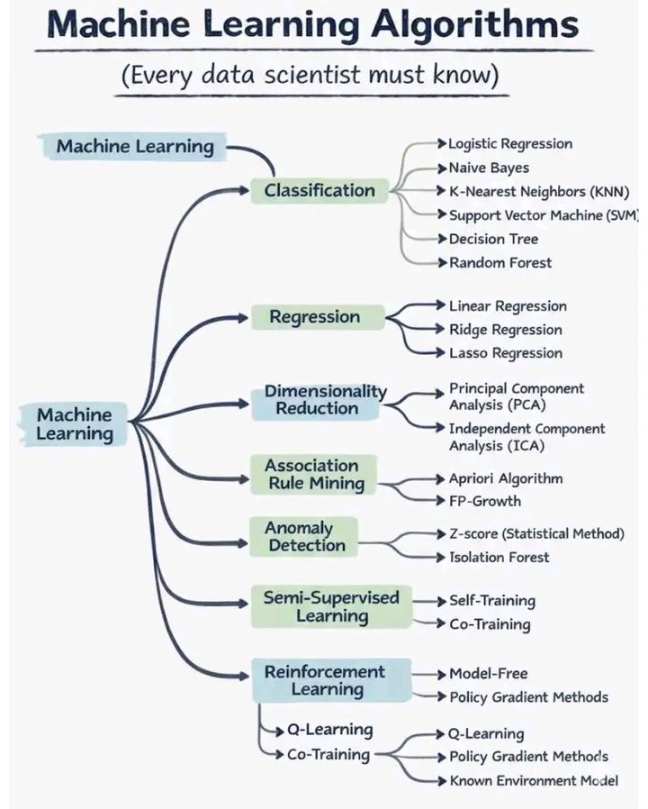
Notes:
Machine Learning Algorithms 𝗠𝗮𝗰𝗵𝗶𝗻𝗲 𝗟𝗲𝗮𝗿𝗻𝗶𝗻𝗴 𝗔𝗹𝗴𝗼𝗿𝗶𝘁𝗵𝗺𝘀 𝗘𝘃𝗲𝗿𝘆 𝗗𝗮𝘁𝗮 𝗦𝗰𝗶𝗲𝗻𝘁𝗶𝘀𝘁 𝗠𝘂𝘀𝘁 𝗞𝗻𝗼𝘄 Animation Coding ✓✓✓ Animation Coding Zone As Machine Learning continues to power modern AI systems, having clarity on when and why to use each algorithm is far more important than just knowing their names. Here’s a structured way to think about the ML landscape 𝗖𝗹𝗮𝘀𝘀𝗶𝗳𝗶𝗰𝗮𝘁𝗶𝗼𝗻 – Predict discrete outcomes Used in fraud detection, spam filtering, churn prediction • Logistic Regression • Naive Bayes • K-Nearest Neighbors (KNN) • Support Vector Machine (SVM) • Decision Tree, Random Forest 𝗥𝗲𝗴𝗿𝗲𝘀𝘀𝗶𝗼𝗻 – Predict continuous values Common in forecasting, pricing, and risk modeling • Linear Regression • Ridge & Lasso Regression (regularization matters!) 𝗗𝗶𝗺𝗲𝗻𝘀𝗶𝗼𝗻𝗮𝗹𝗶𝘁𝘆 𝗥𝗲𝗱𝘂𝗰𝘁𝗶𝗼𝗻 – Simplify data, reduce noise Critical for visualization and performance optimization • PCA (Principal Component Analysis) • ICA (Independent Component Analysis) 𝗔𝘀𝘀𝗼𝗰𝗶𝗮𝘁𝗶𝗼𝗻 𝗥𝘂𝗹𝗲 𝗠𝗶𝗻𝗶𝗻𝗴 – Discover hidden patterns Often used in market basket analysis and recommendations • Apriori • FP-Growth 𝗔𝗻𝗼𝗺𝗮𝗹𝘆 𝗗𝗲𝘁𝗲𝗰𝘁𝗶𝗼𝗻 – Identify rare or abnormal behavior Essential for security, monitoring, and quality control • Z-Score (statistical baseline) • Isolation Forest 𝗦𝗲𝗺𝗶-𝗦𝘂𝗽𝗲𝗿𝘃𝗶𝘀𝗲𝗱 𝗟𝗲𝗮𝗿𝗻𝗶𝗻𝗴 – Learn with limited labels Very useful when labeled data is expensive • Self-Training • Co-Training 𝗥𝗲𝗶𝗻𝗳𝗼𝗿𝗰𝗲𝗺𝗲𝗻𝘁 𝗟𝗲𝗮𝗿𝗻𝗶𝗻𝗴 – Learn by interaction and reward Drives robotics, gaming, and decision-making systems • Q-Learning • Policy Gradient Methods • Model-Free vs Model-Based approaches 𝗘𝘅𝗽𝗲𝗿𝘁 𝘁𝗶𝗽: Don’t choose algorithms in isolation. Always consider: • Business objective • Data size & quality • Interpretability vs performance • Deployment constraints Mastering these fundamentals builds the foundation for advanced topics like deep learning, LLMs, and agentic AI. #Animationcoding #Azcone #coding #development #programming #machinelearning #CodeLife #code #Efficiency #aiphoto #API #APIIntegration

Slide 3
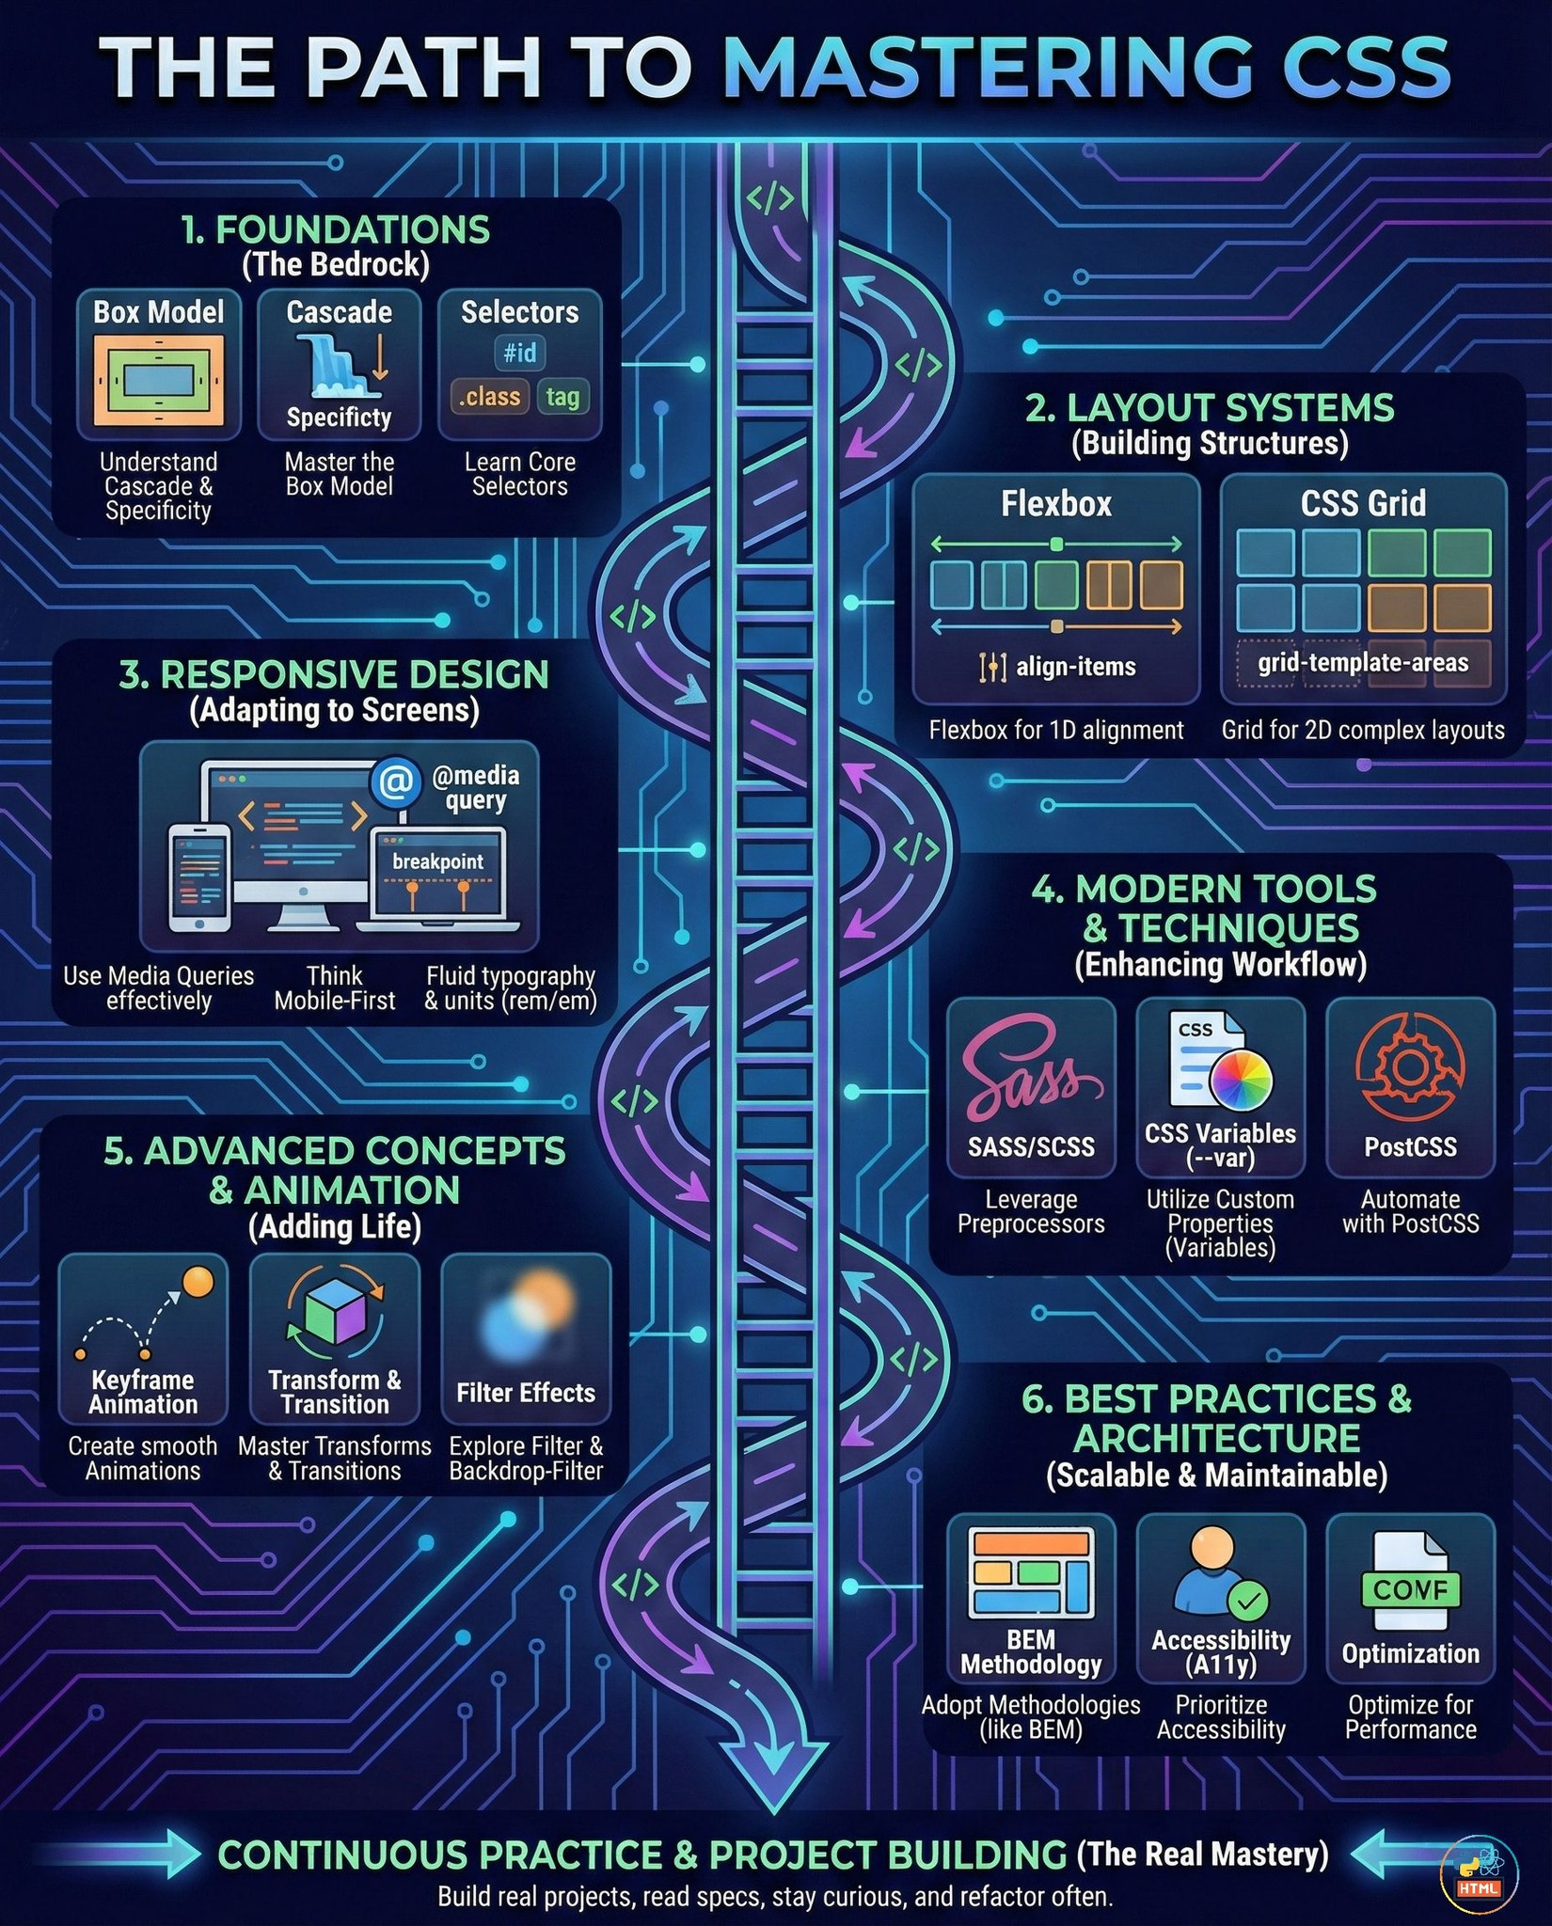

Slide 4
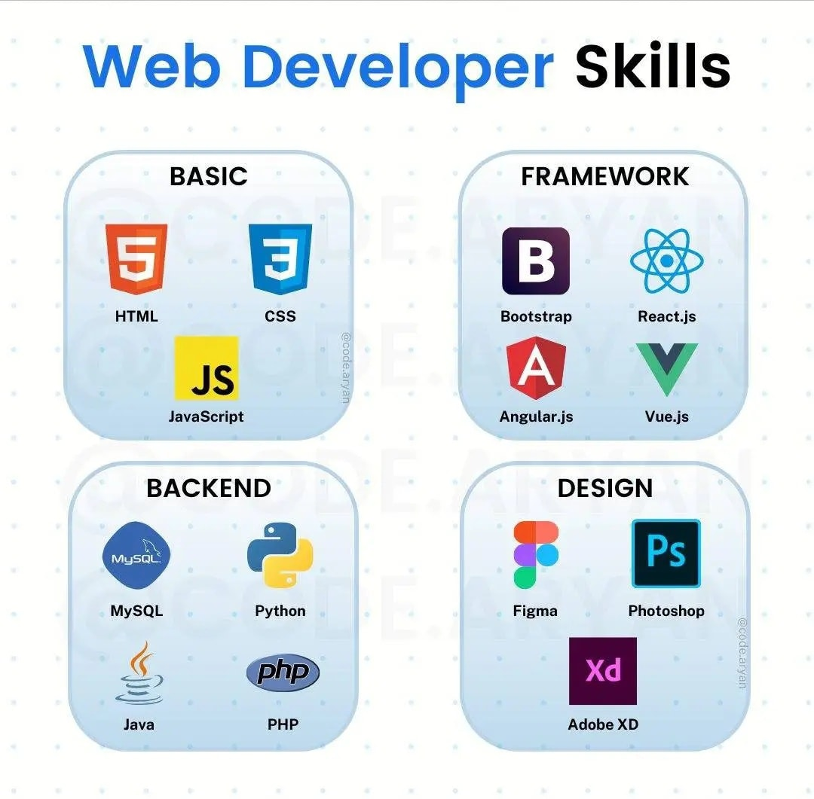

Slide 5
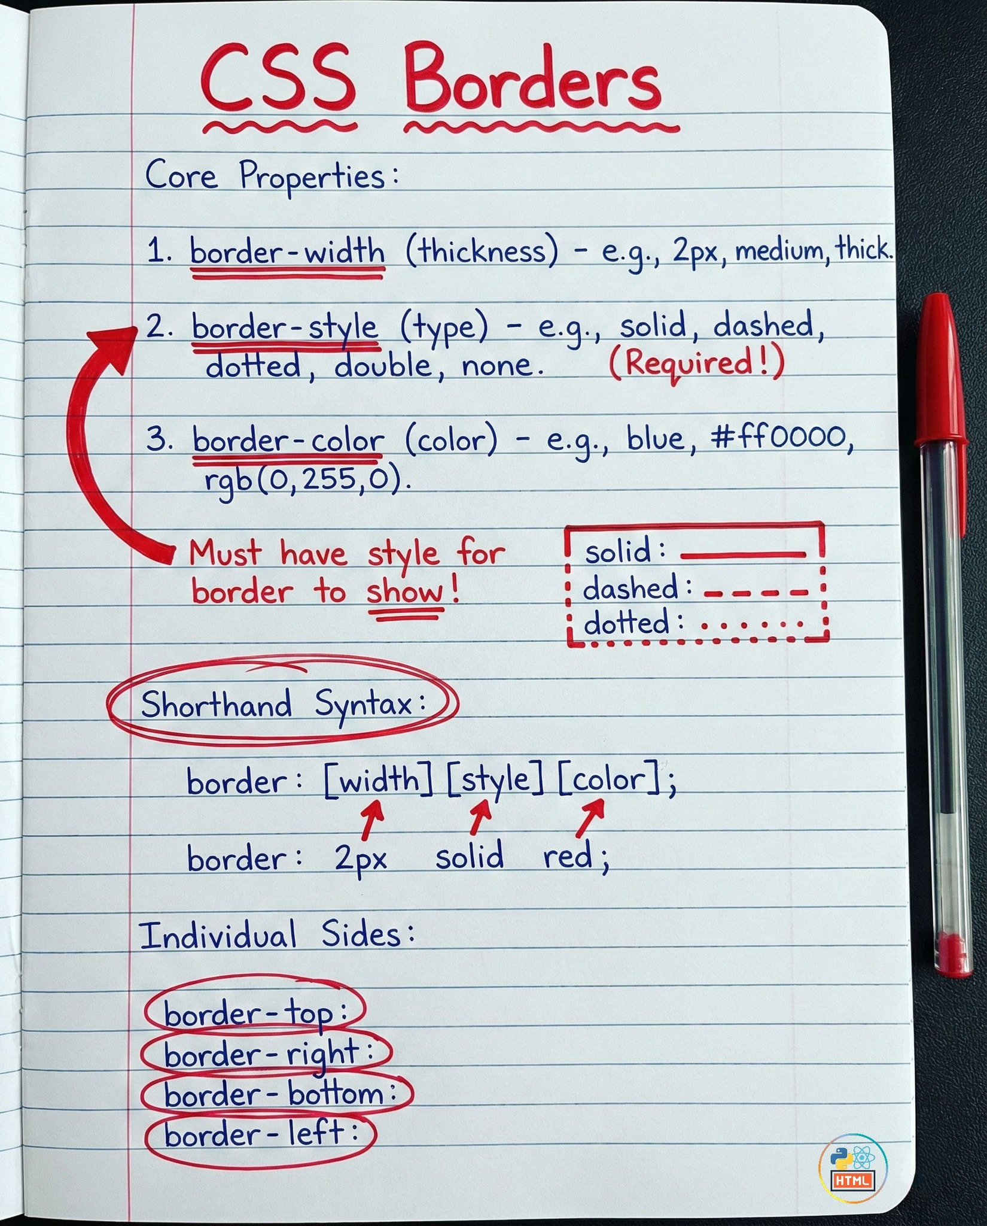
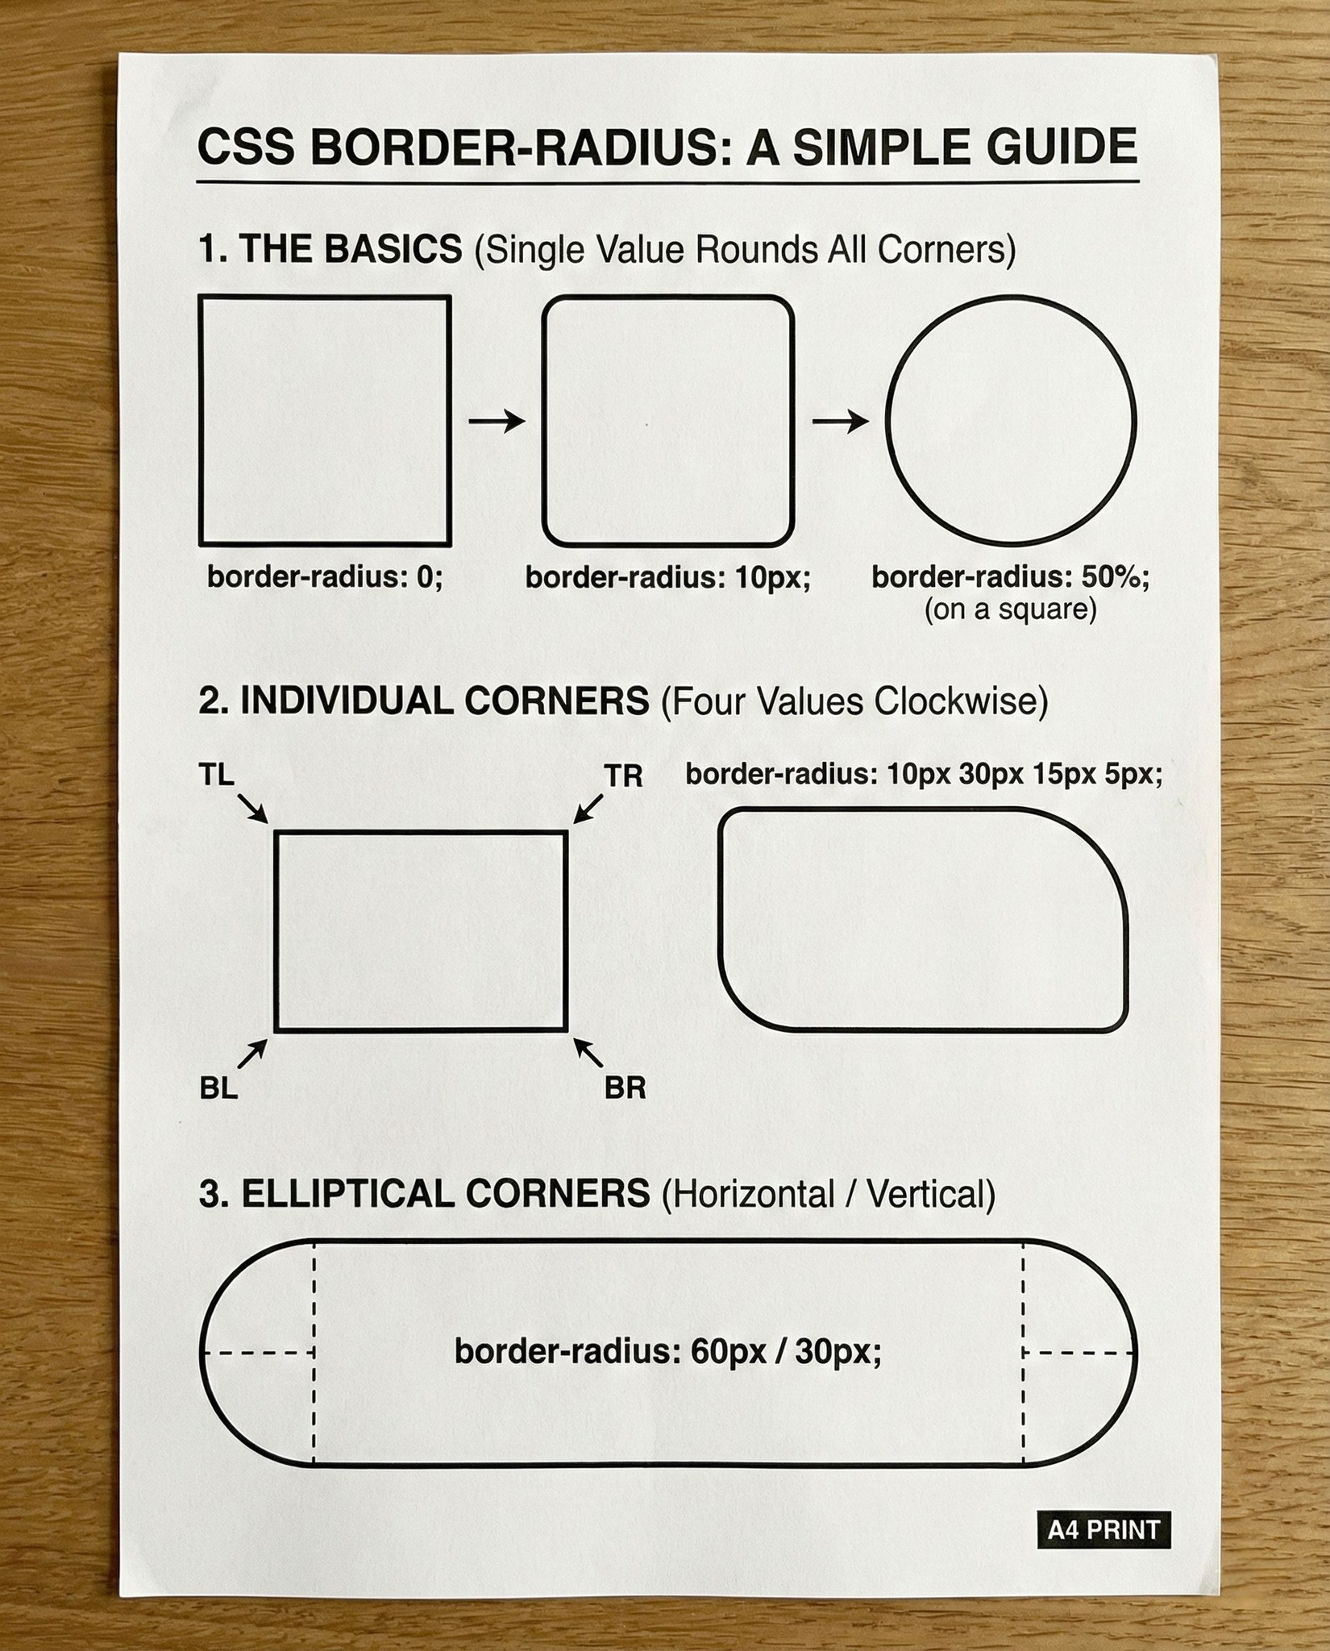

Slide 6
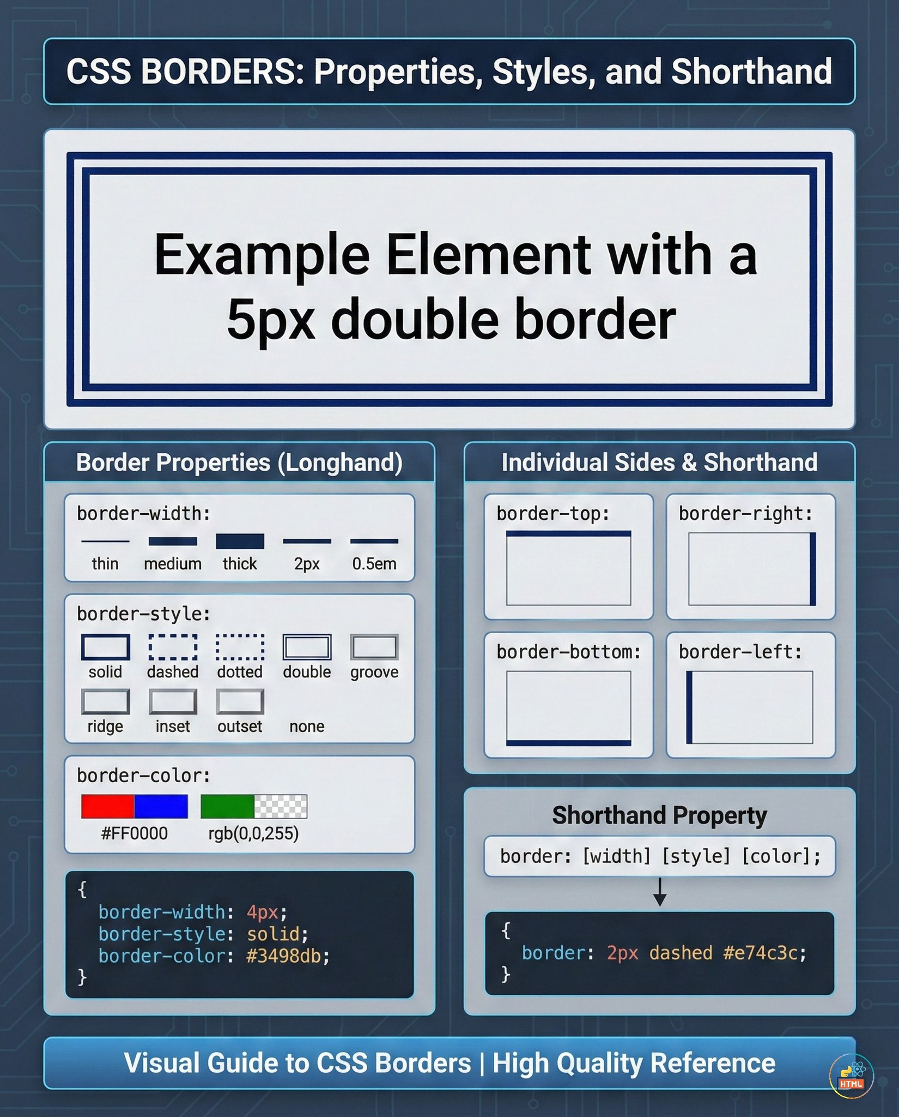

Slide 7
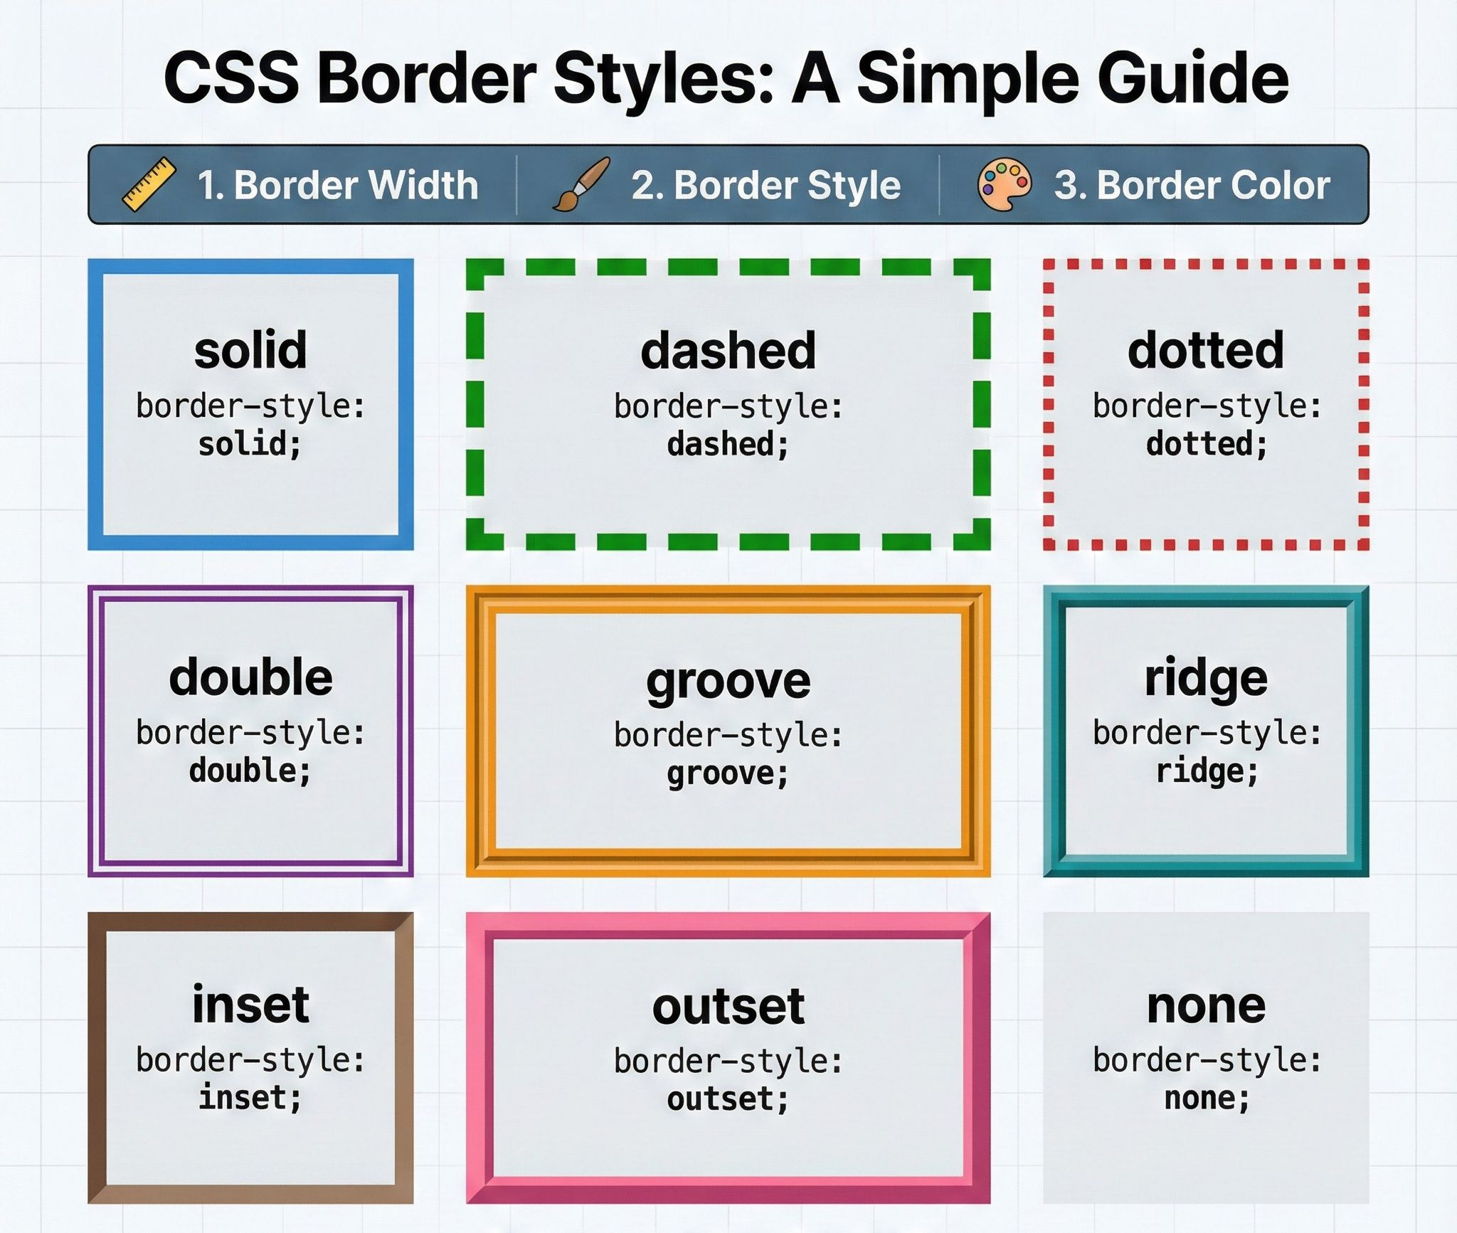

Slide 8
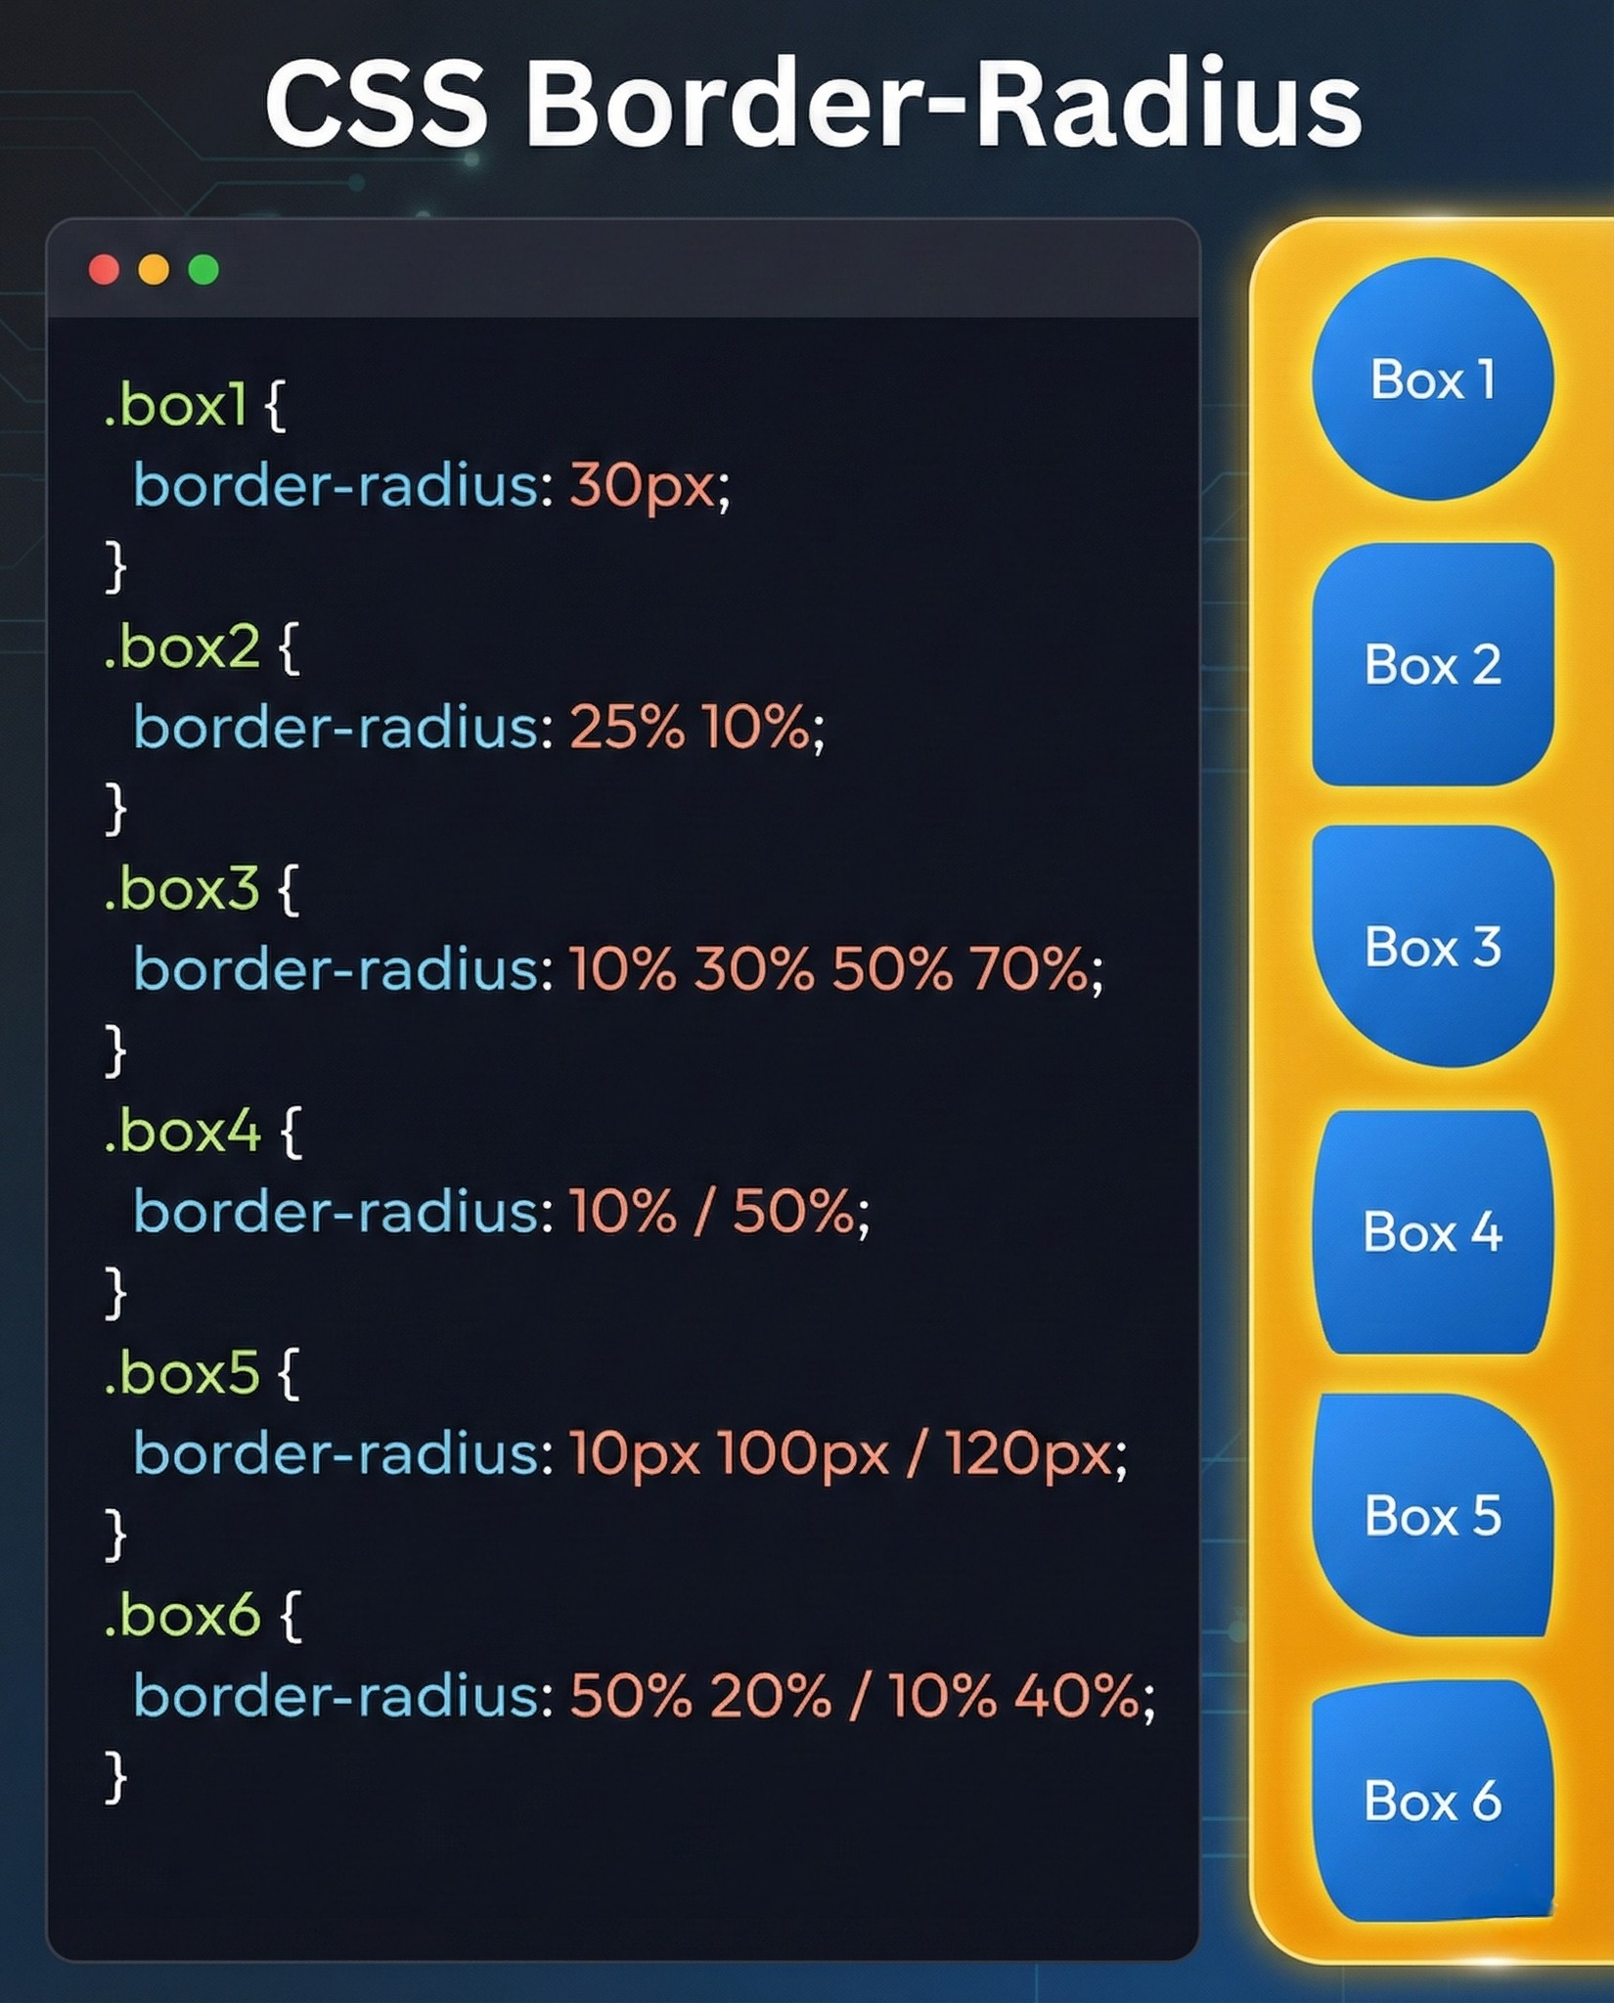

Slide 9
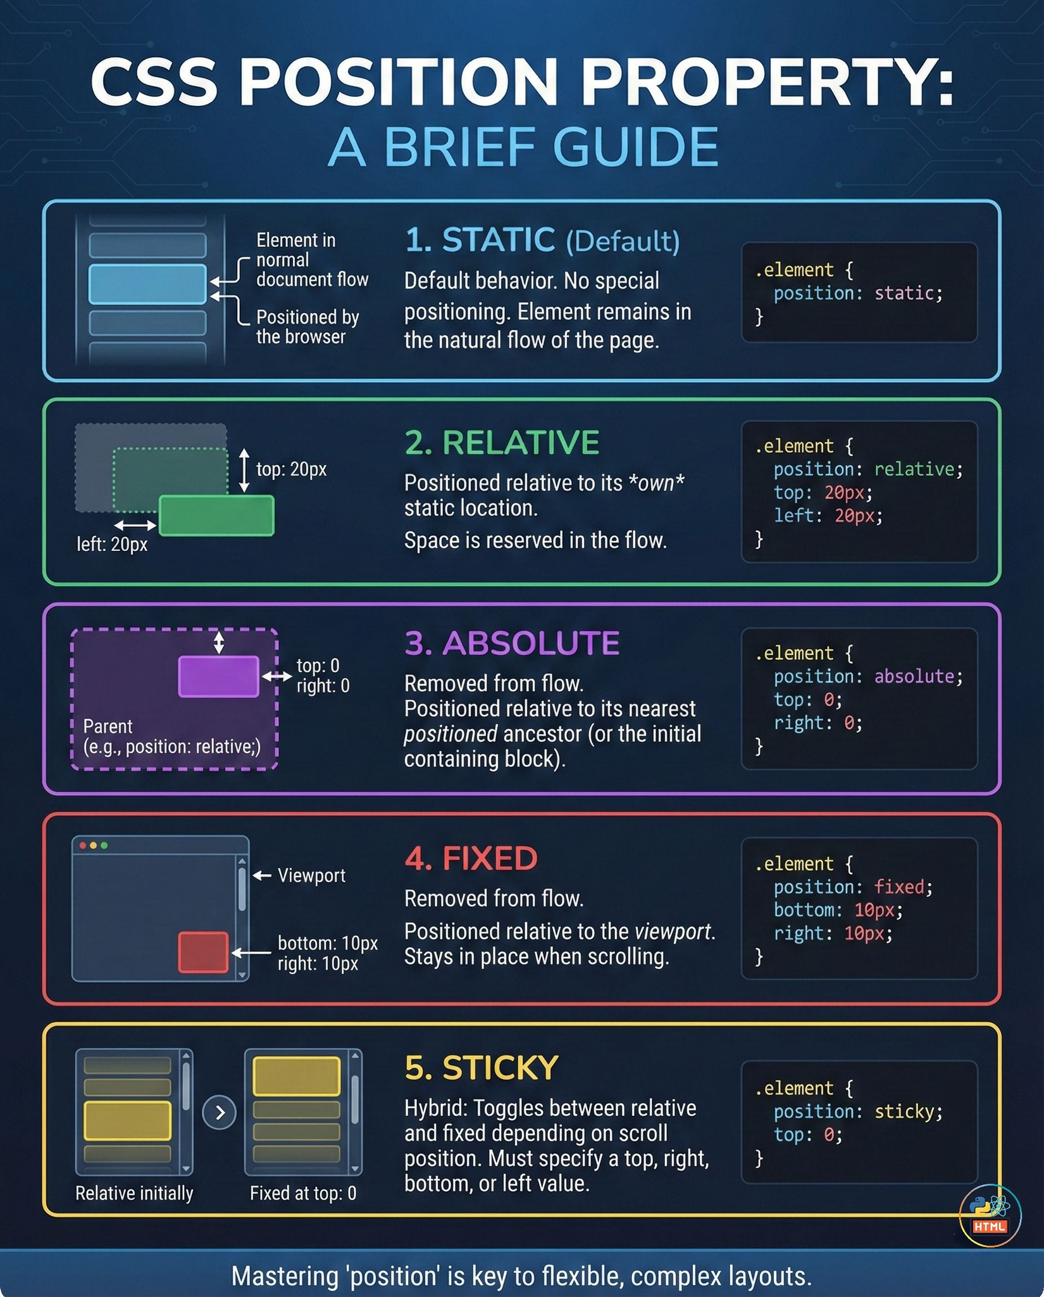
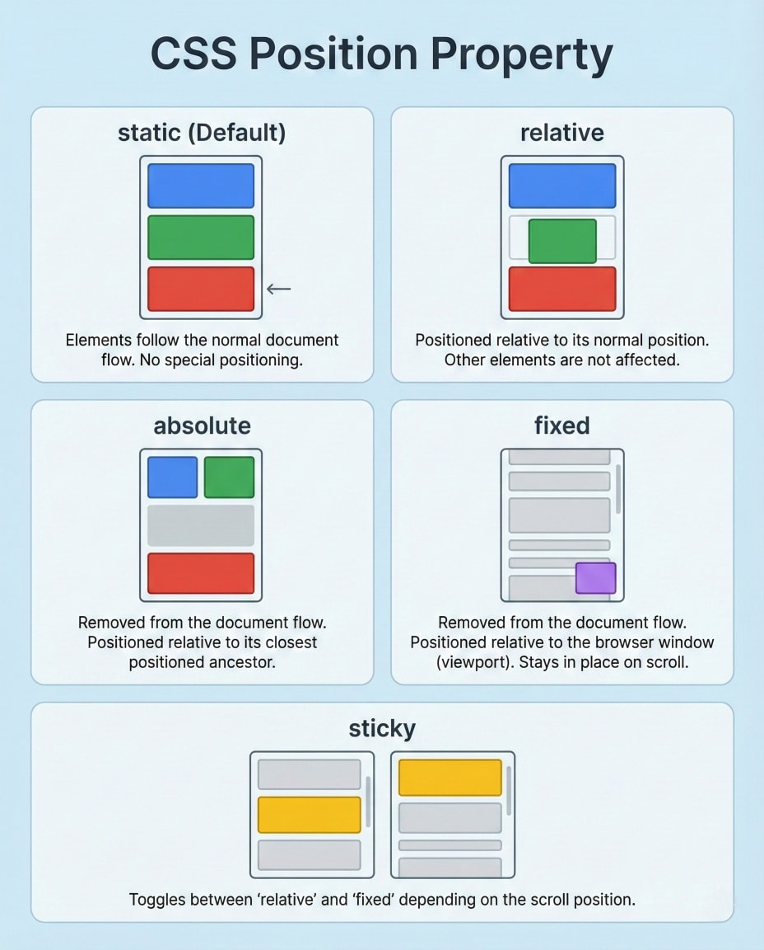

Slide 10
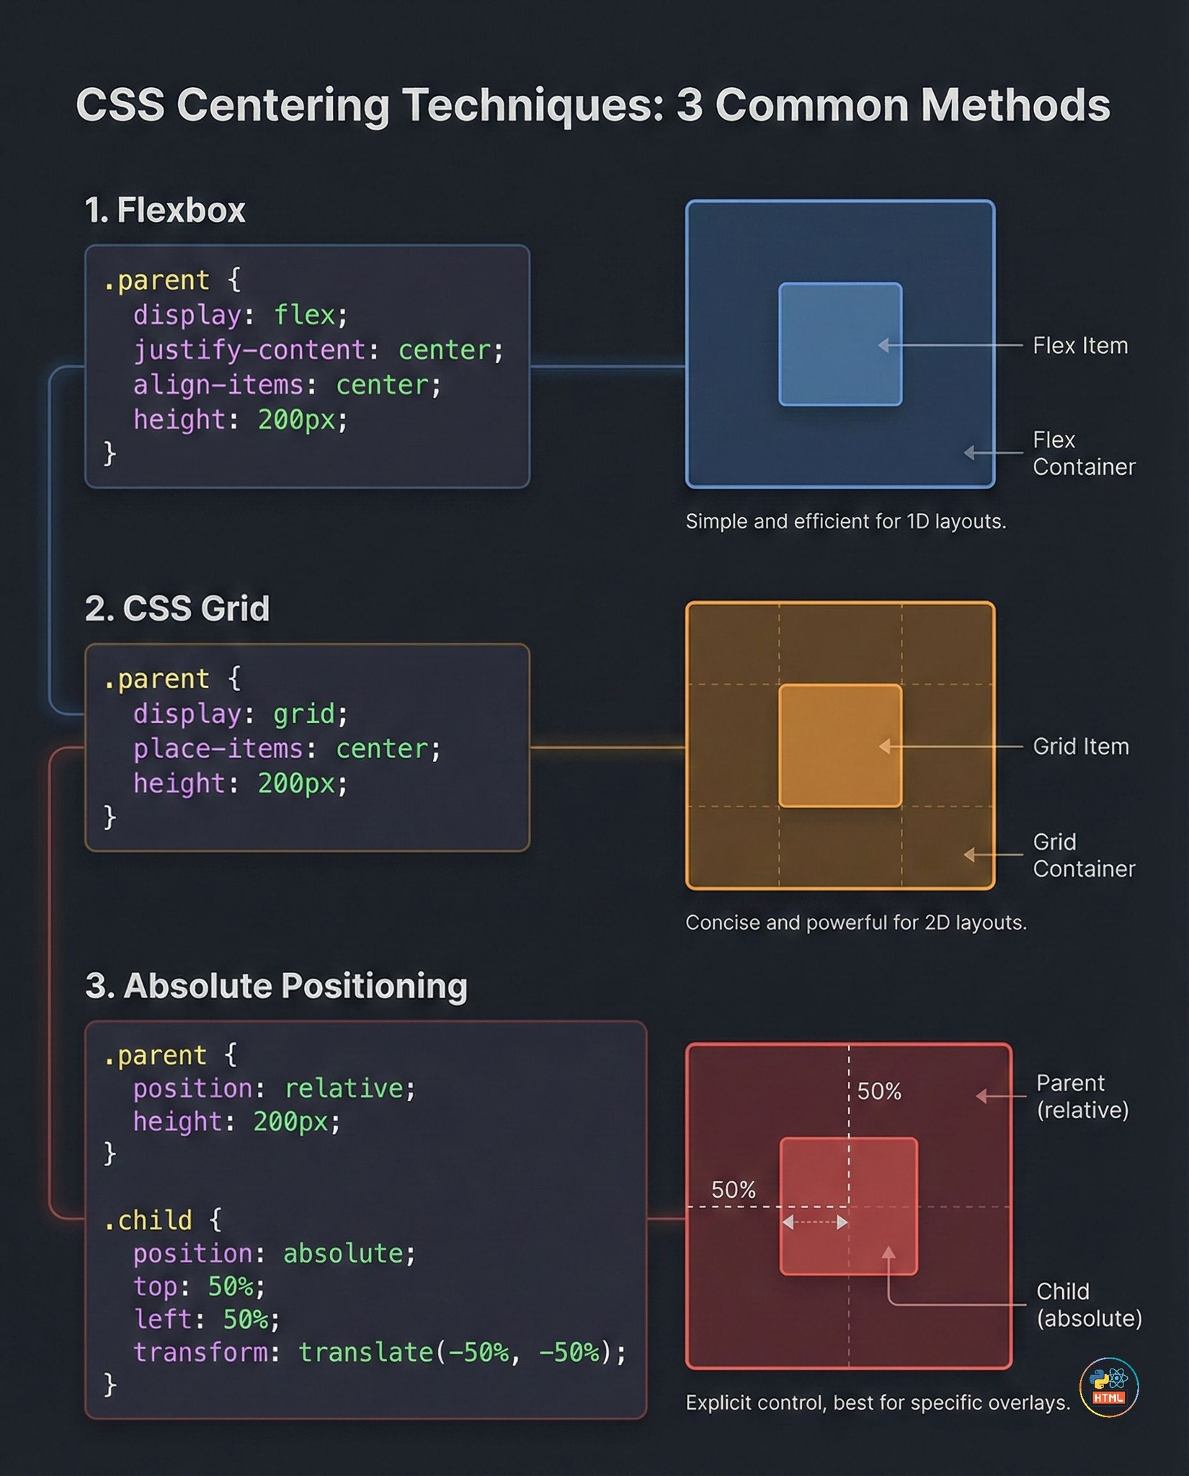

Slide 11
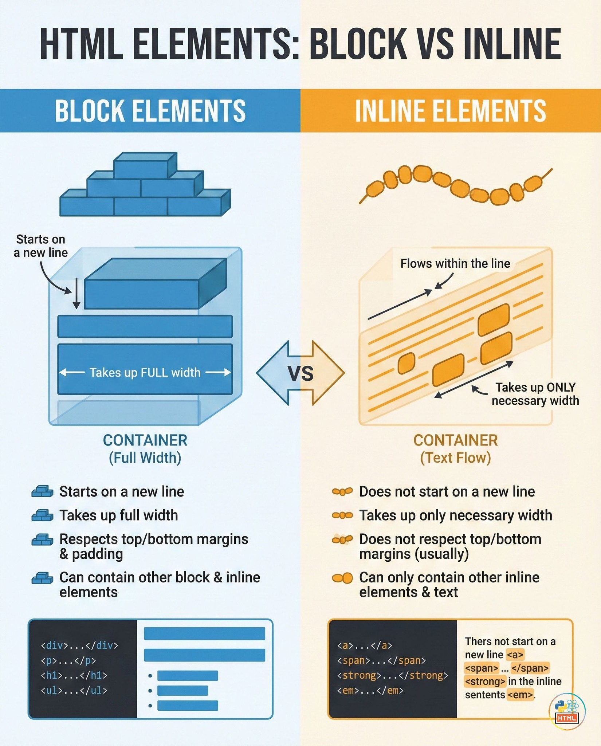

Slide 12
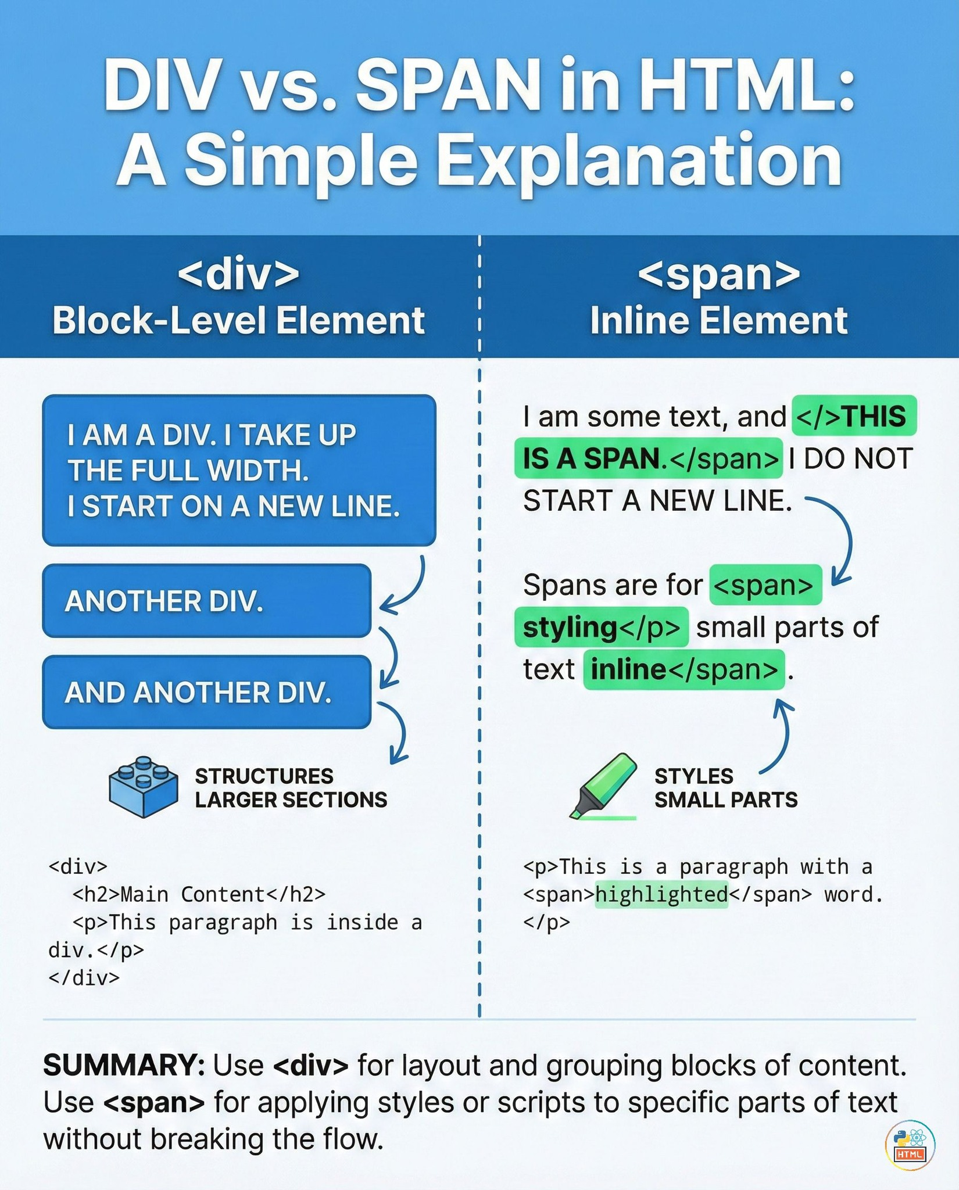

Slide 13
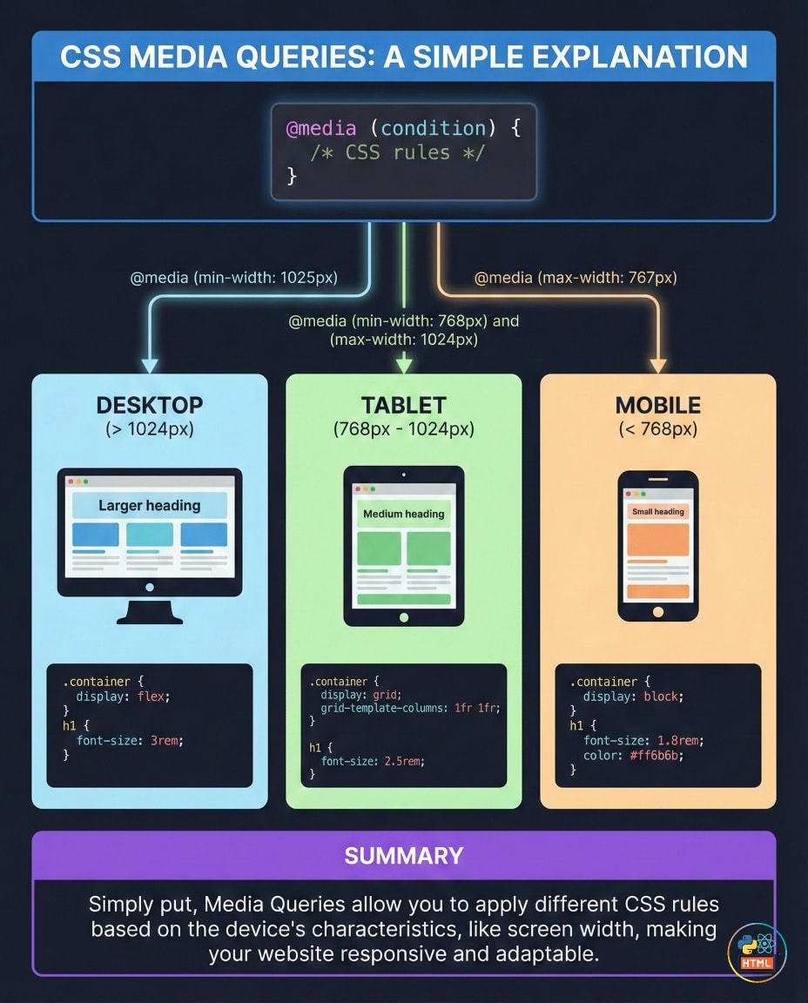

Slide 14
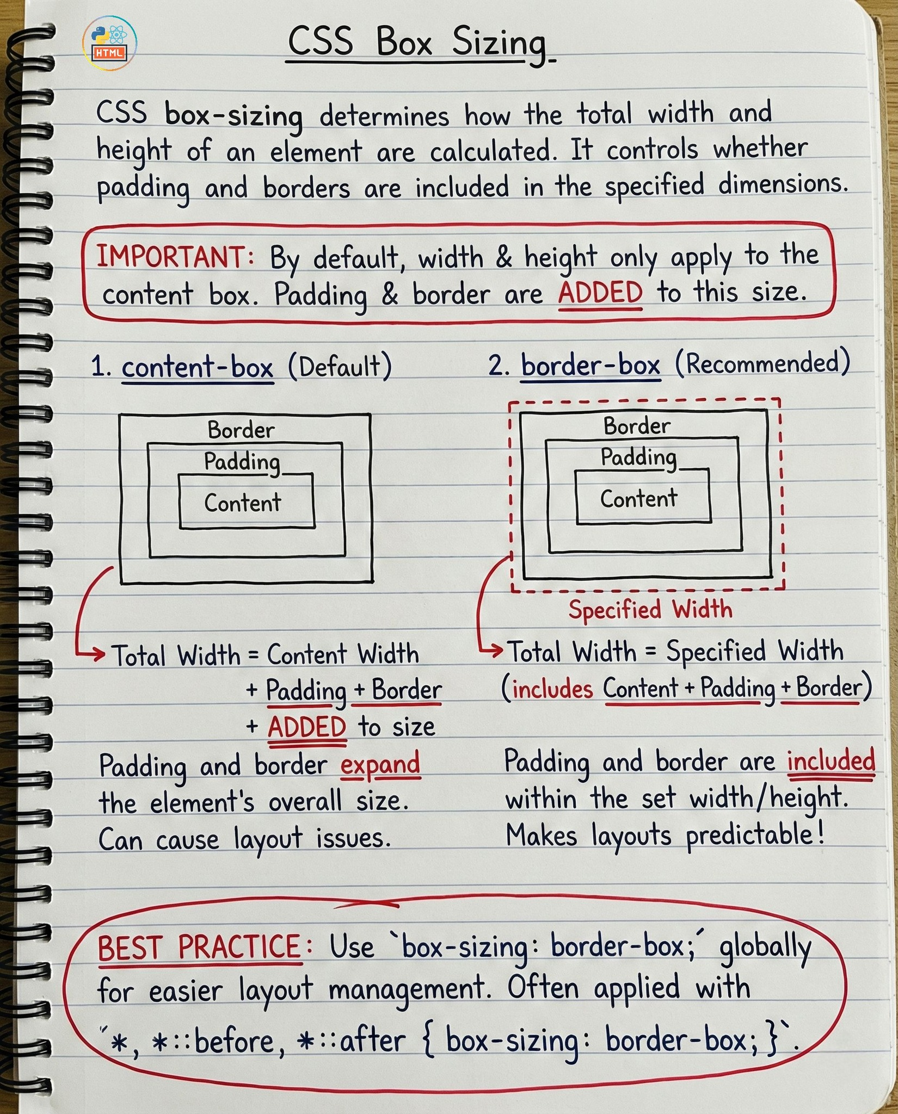

Slide 15
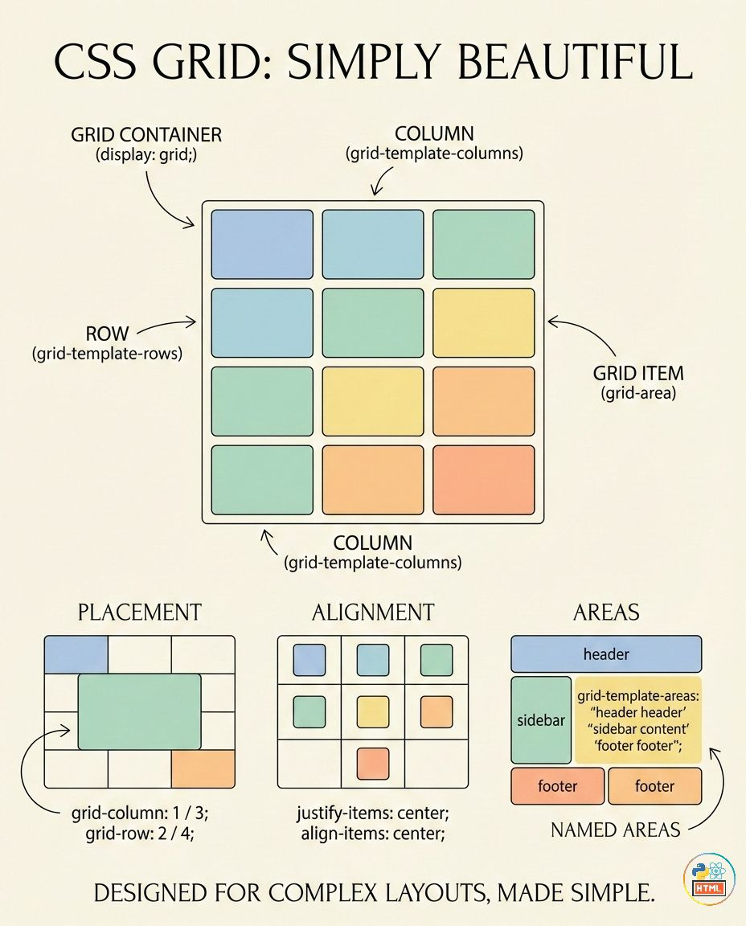
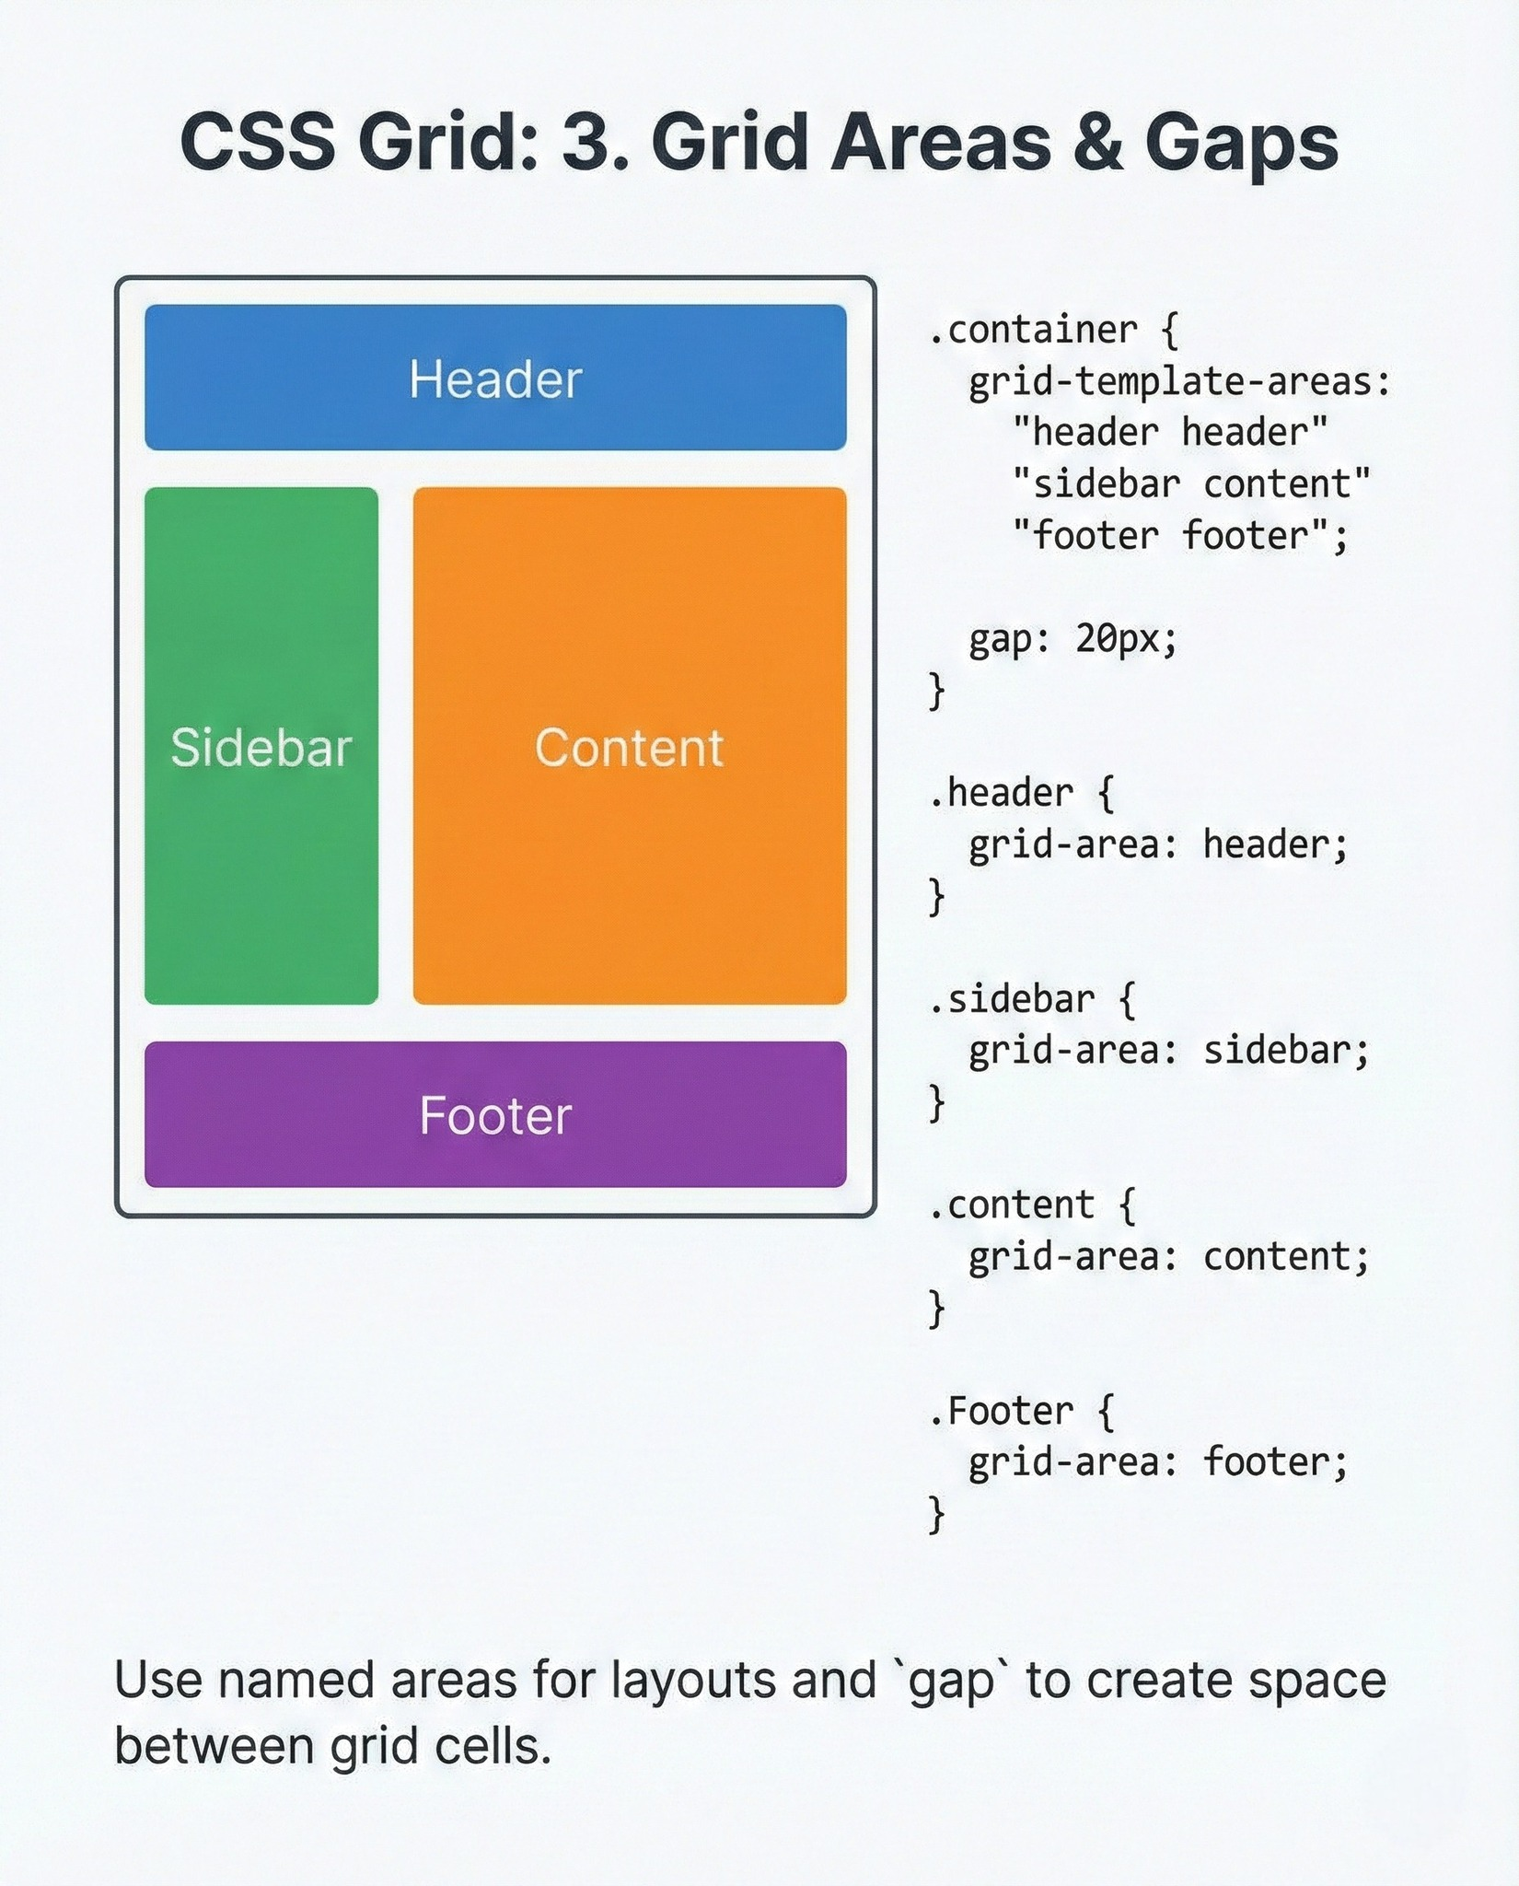

Slide 16
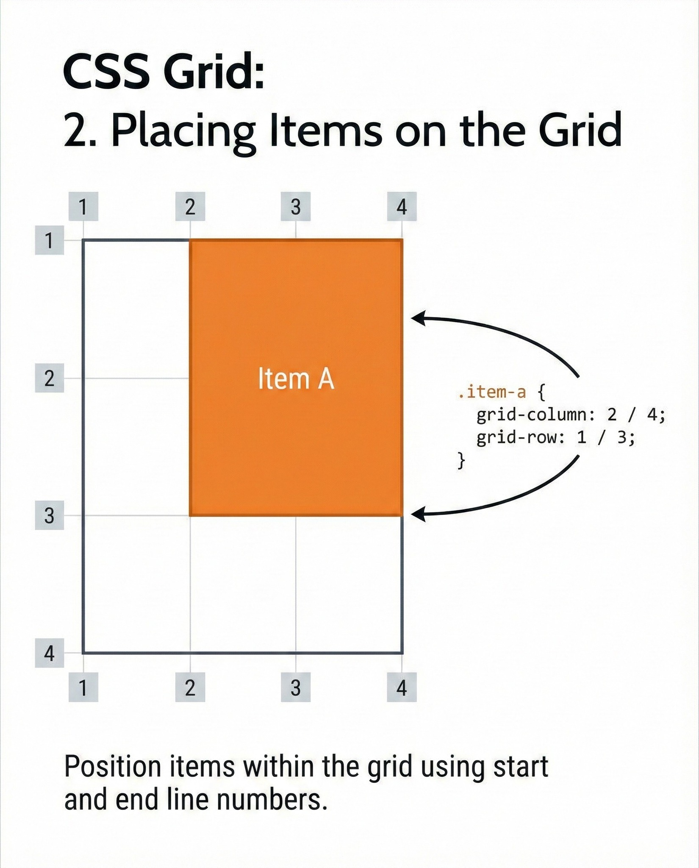
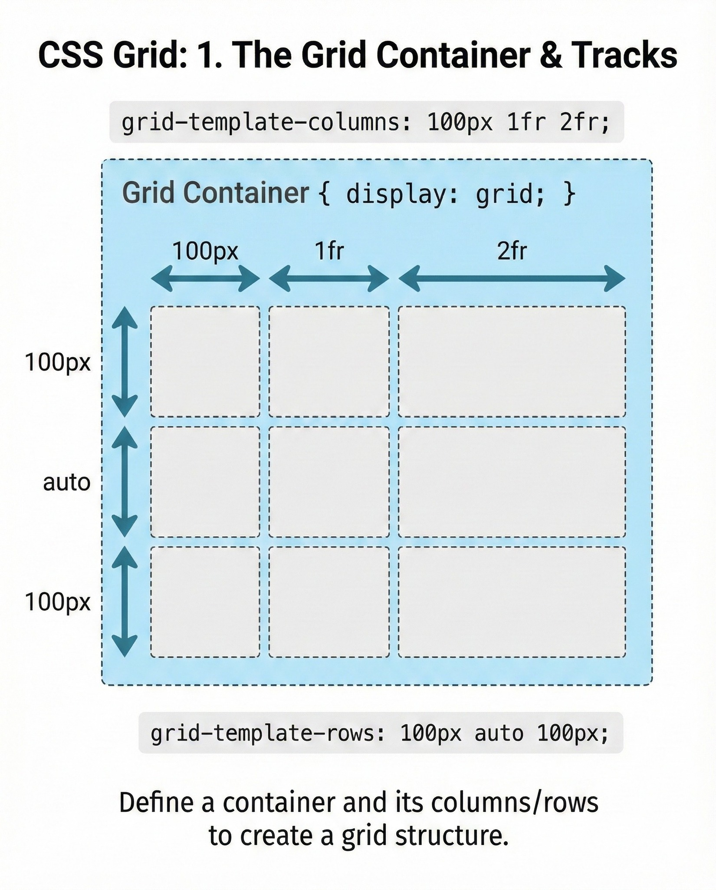

Slide 17
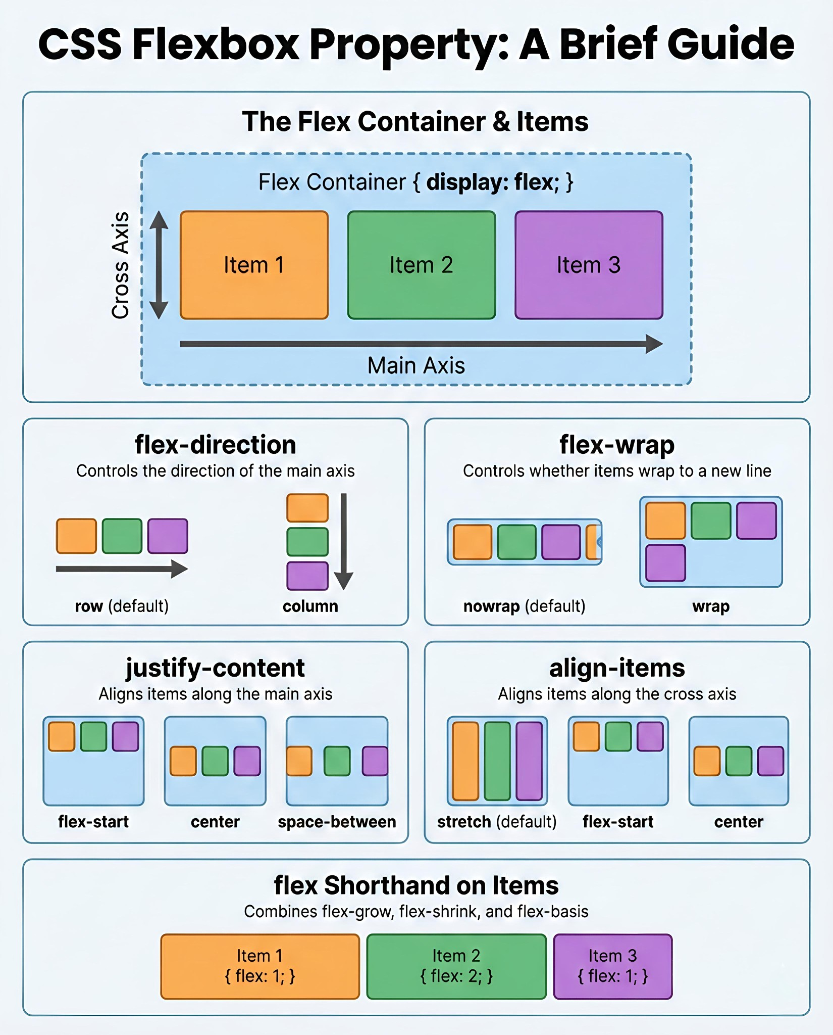

Slide 18


Slide 19
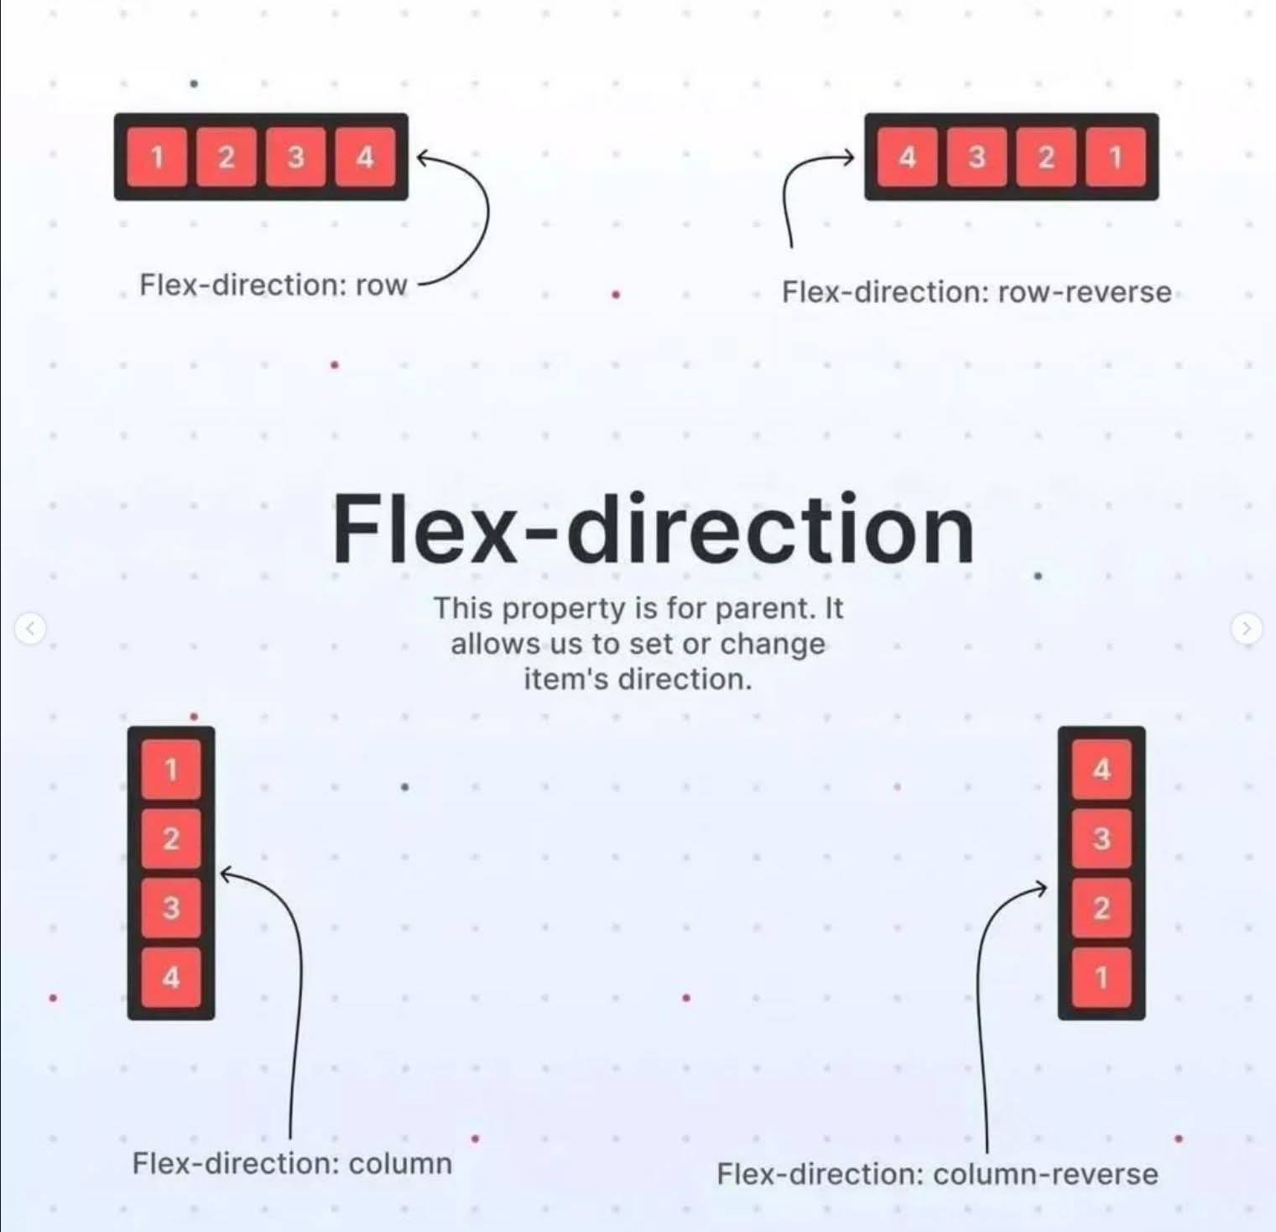

Slide 20
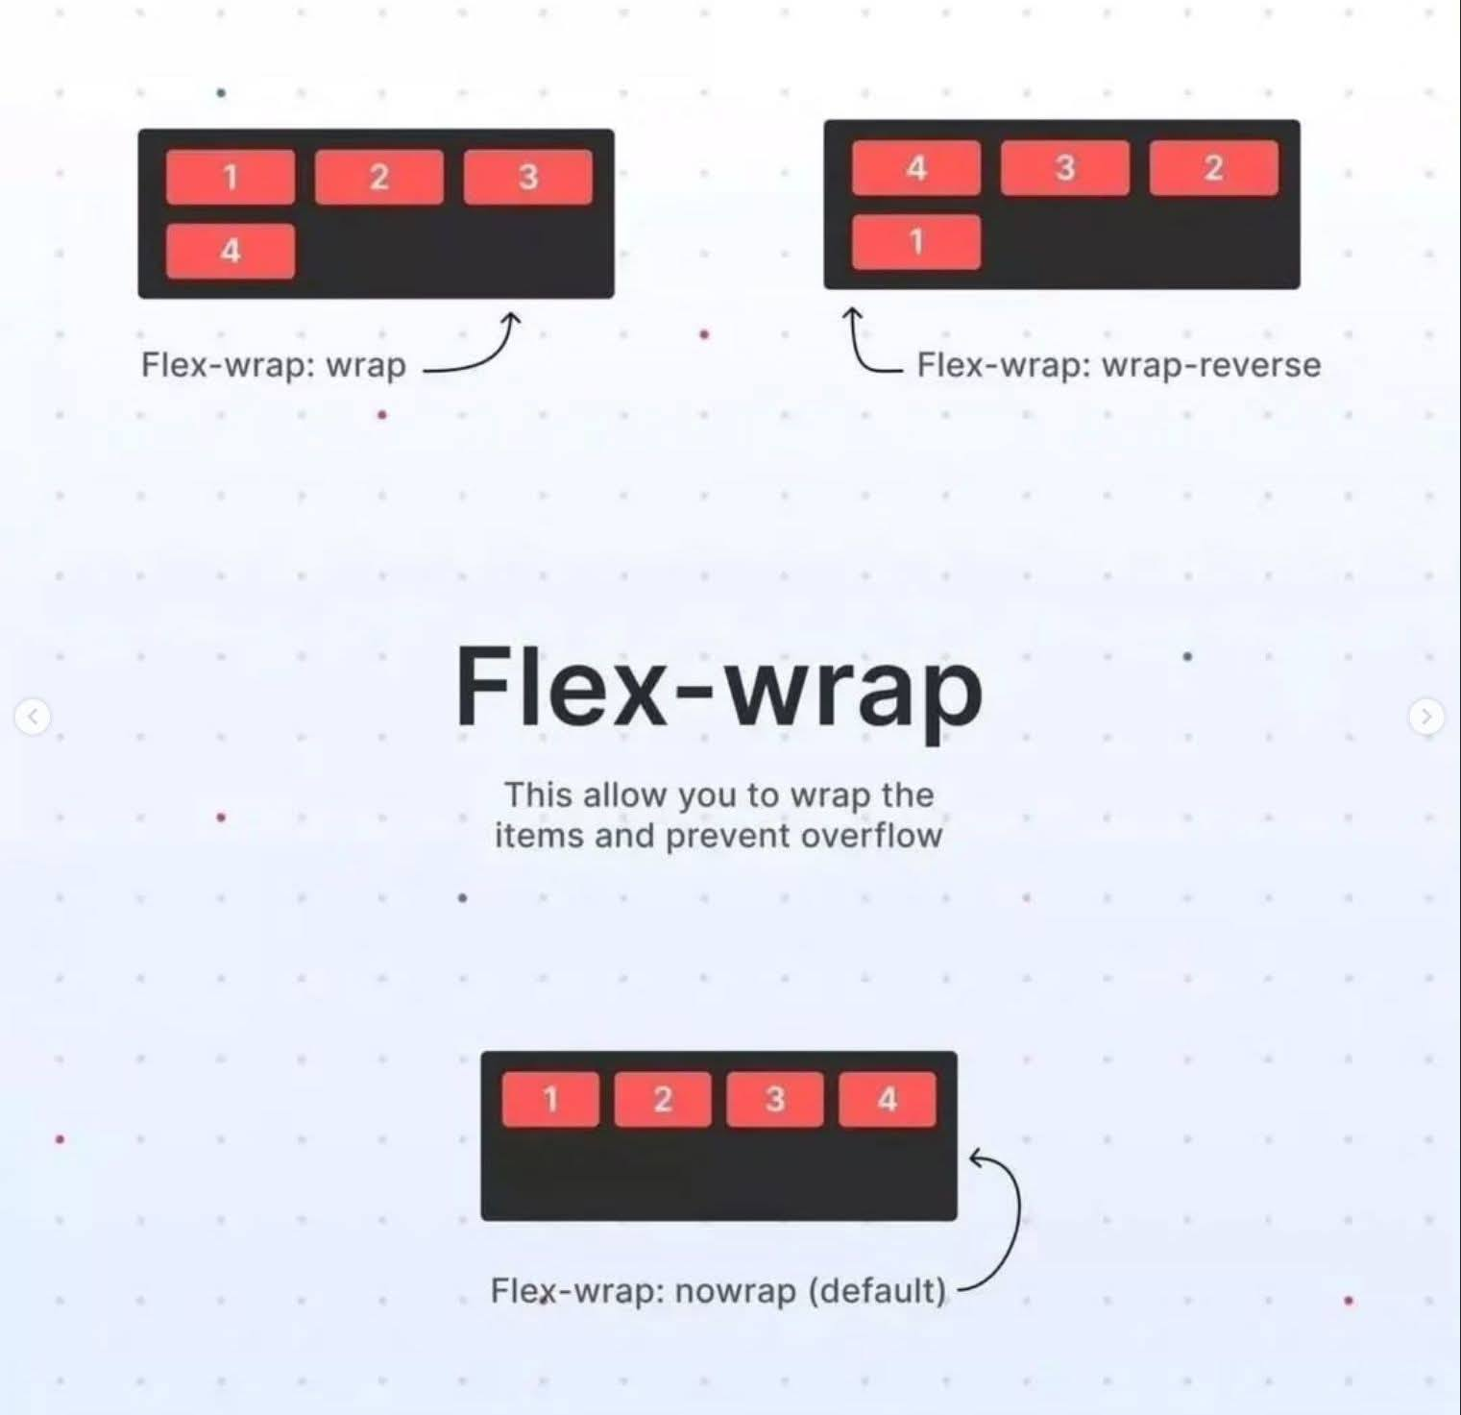

Slide 21
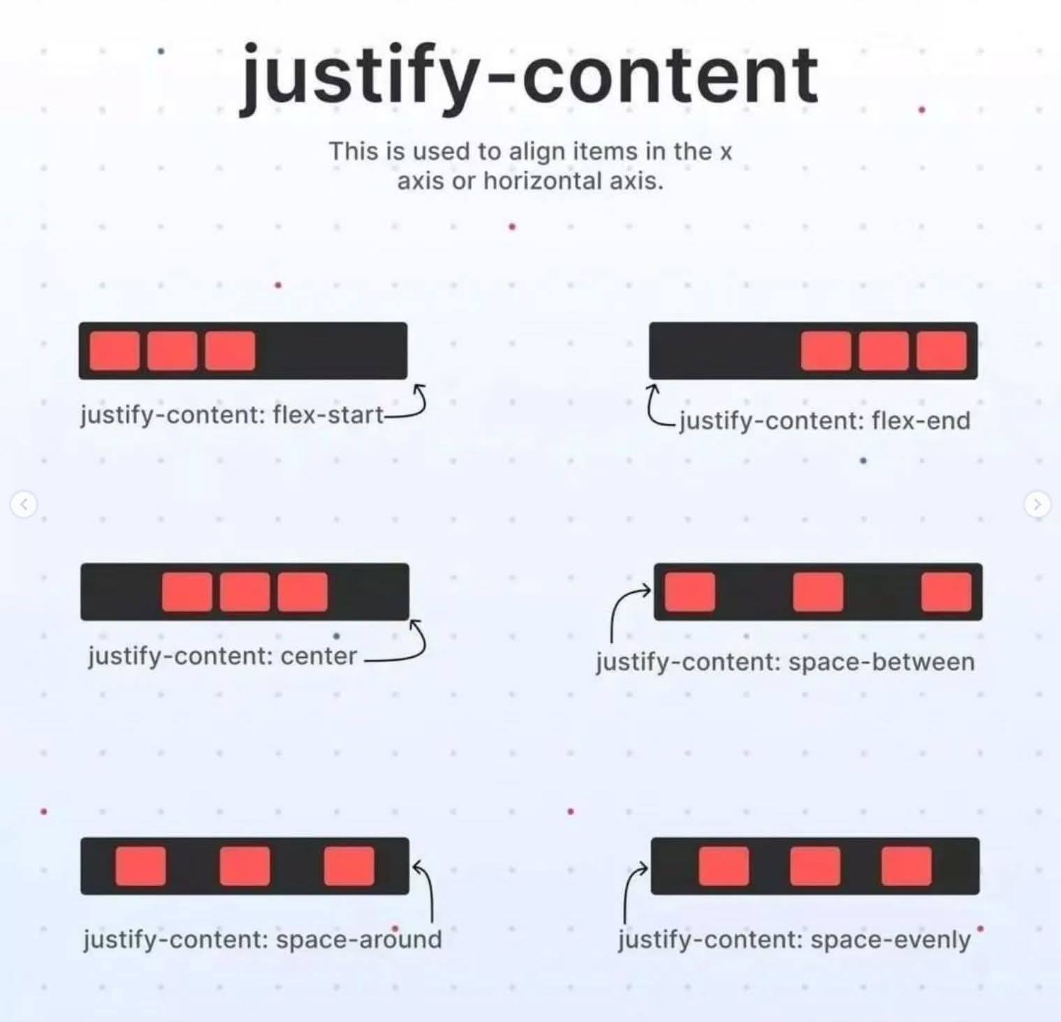

Slide 22
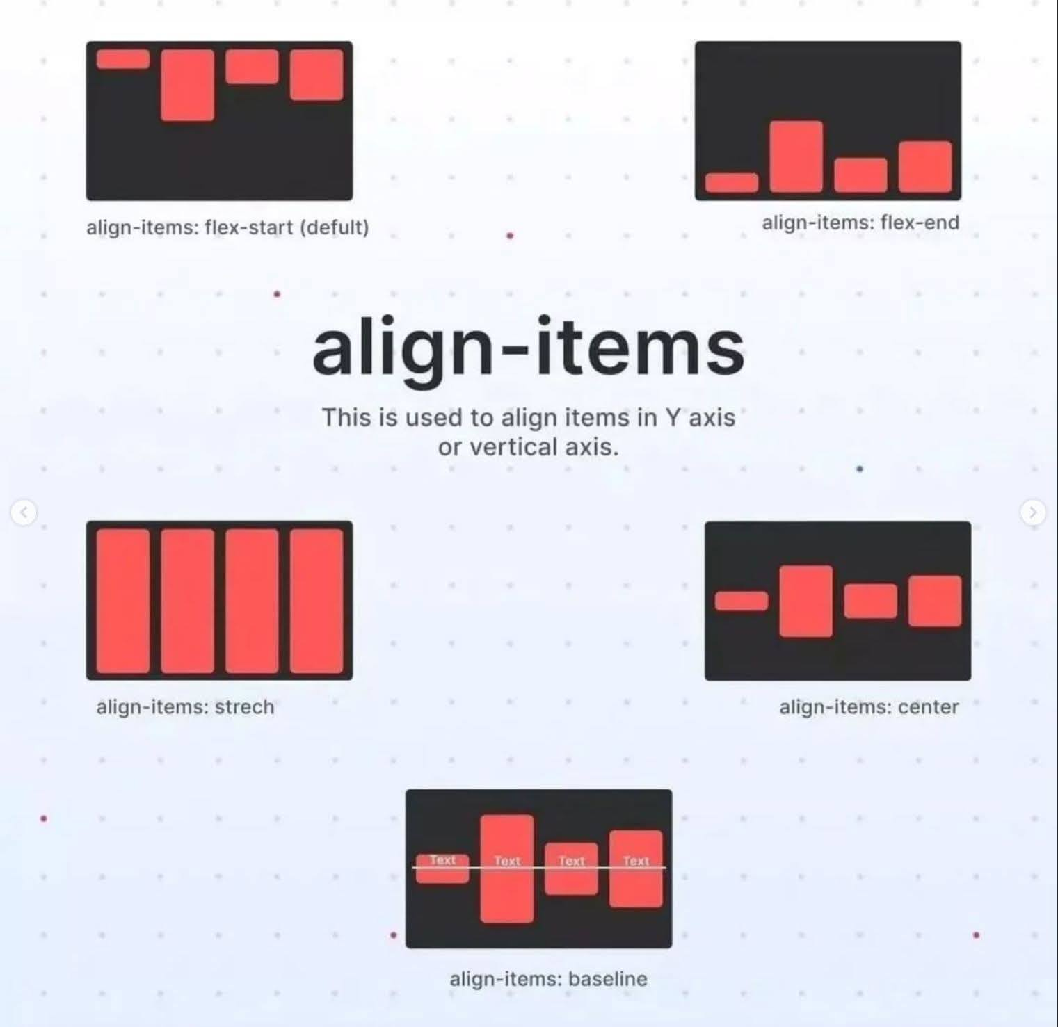

Slide 23
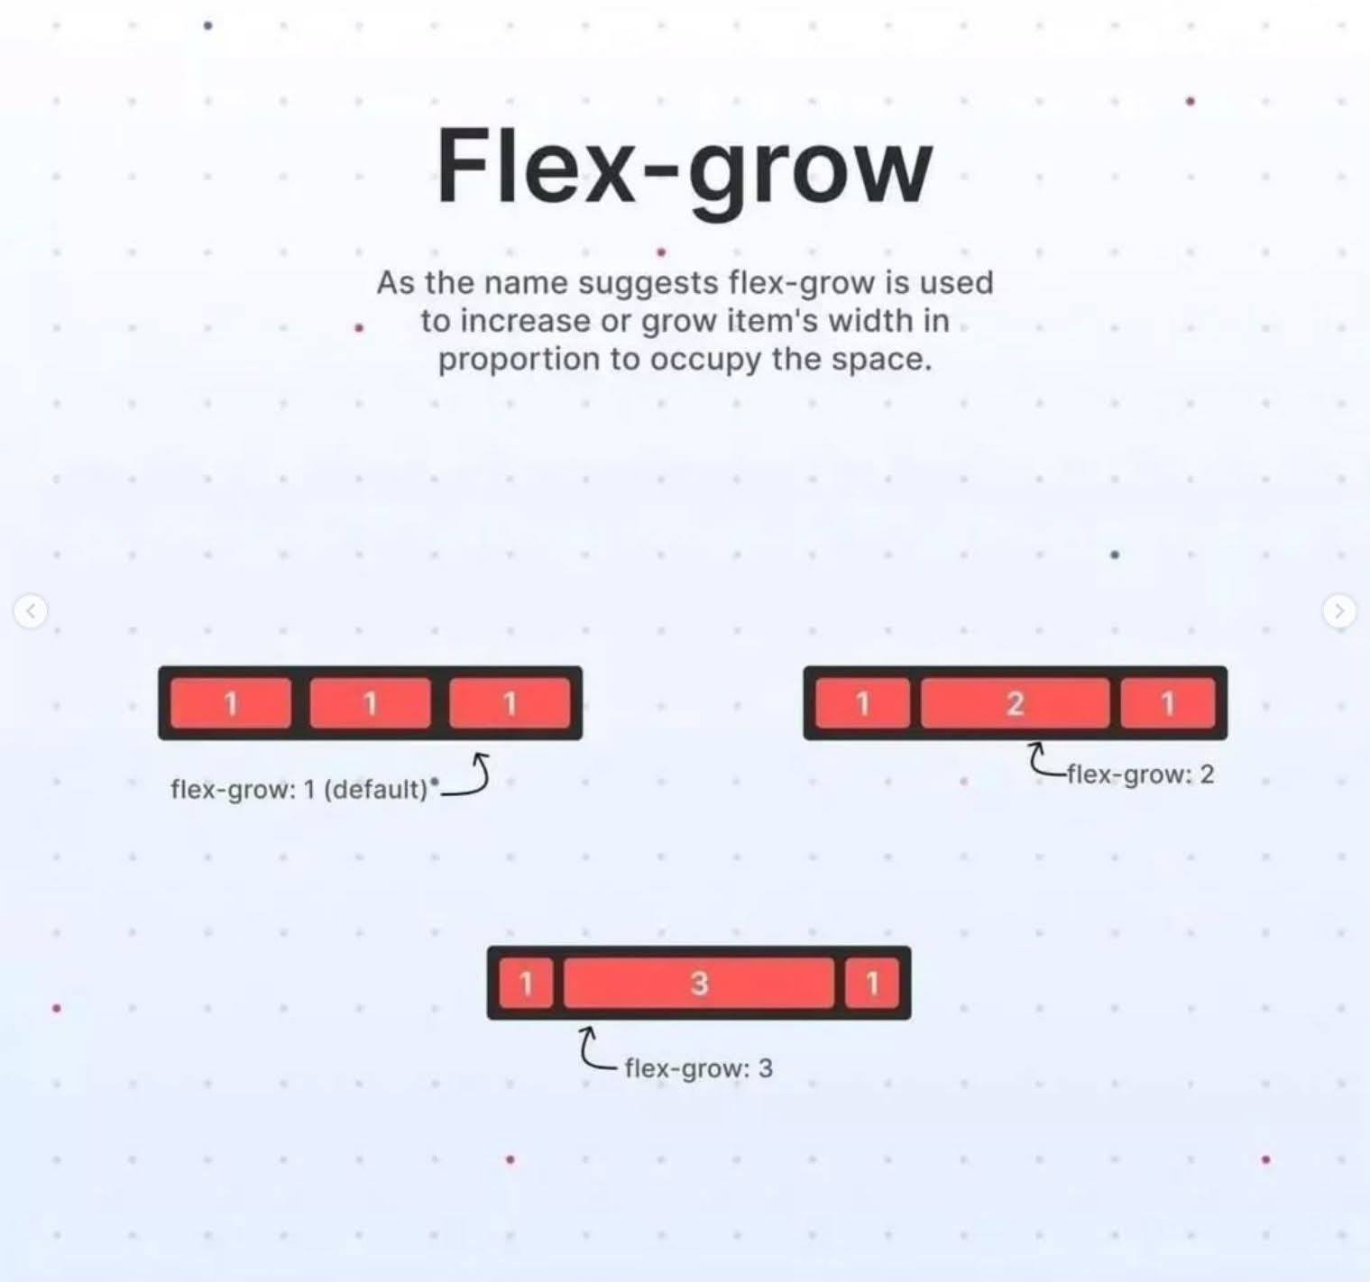

Slide 24
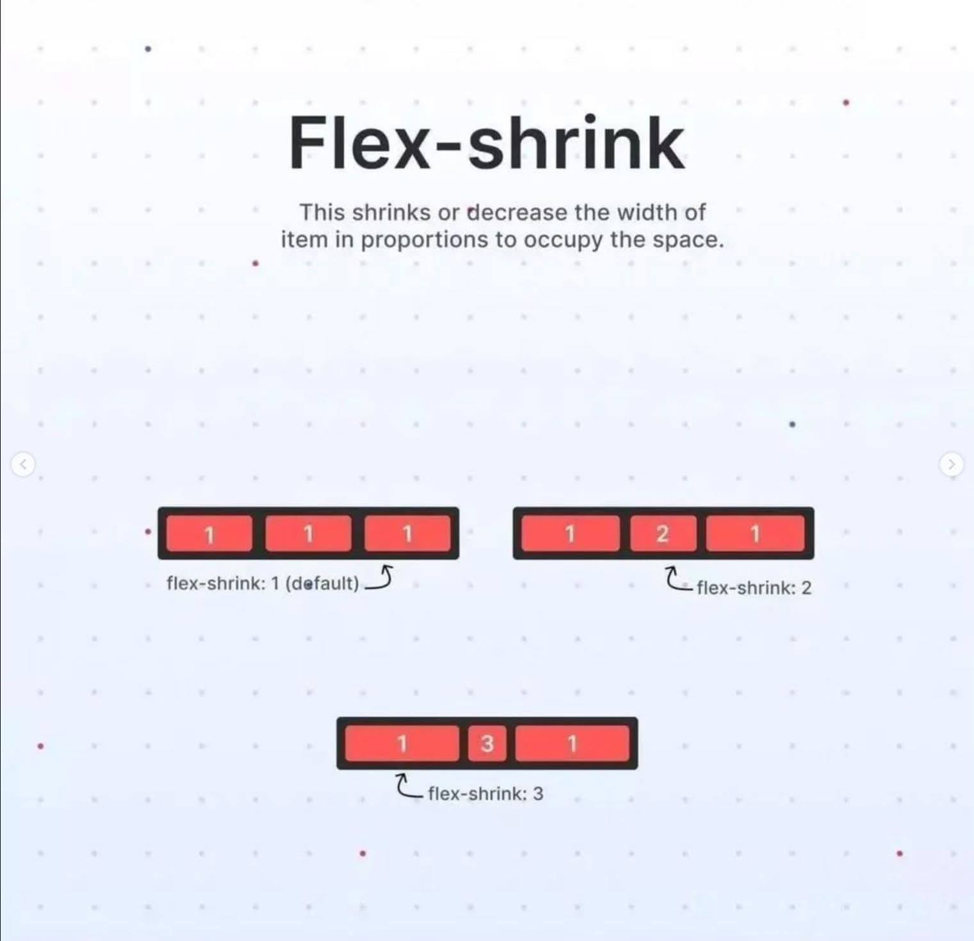

Slide 25
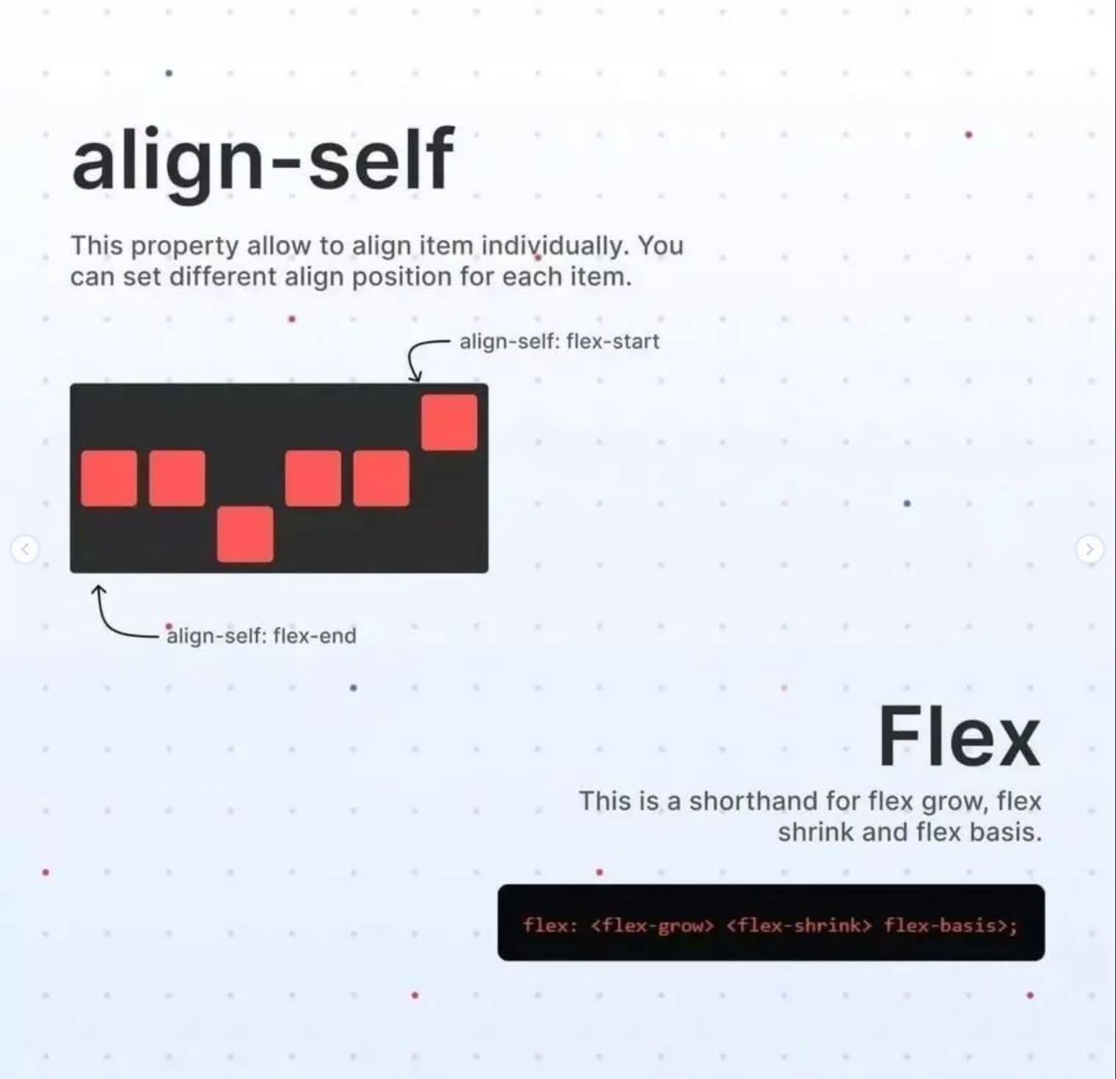

Slide 26
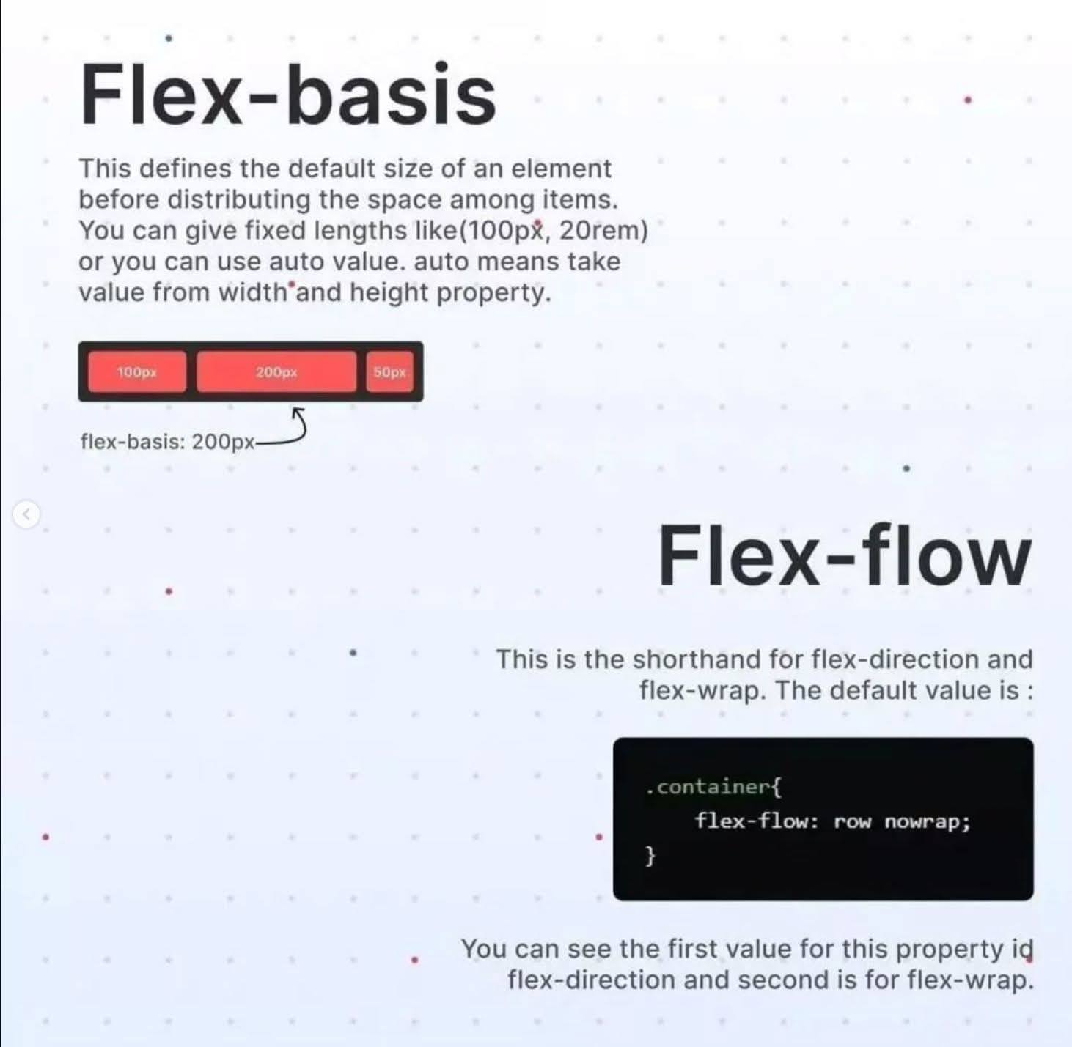

Slide 28
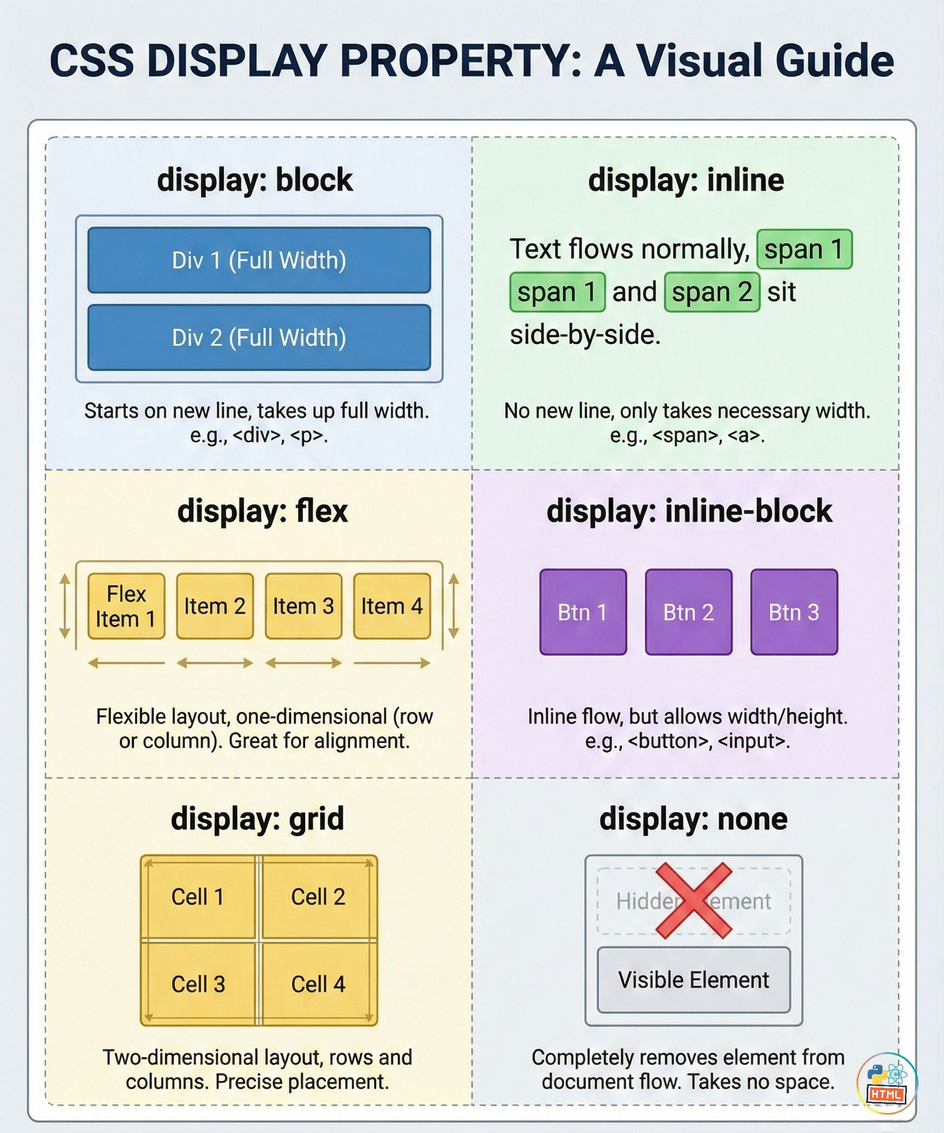

Slide 29
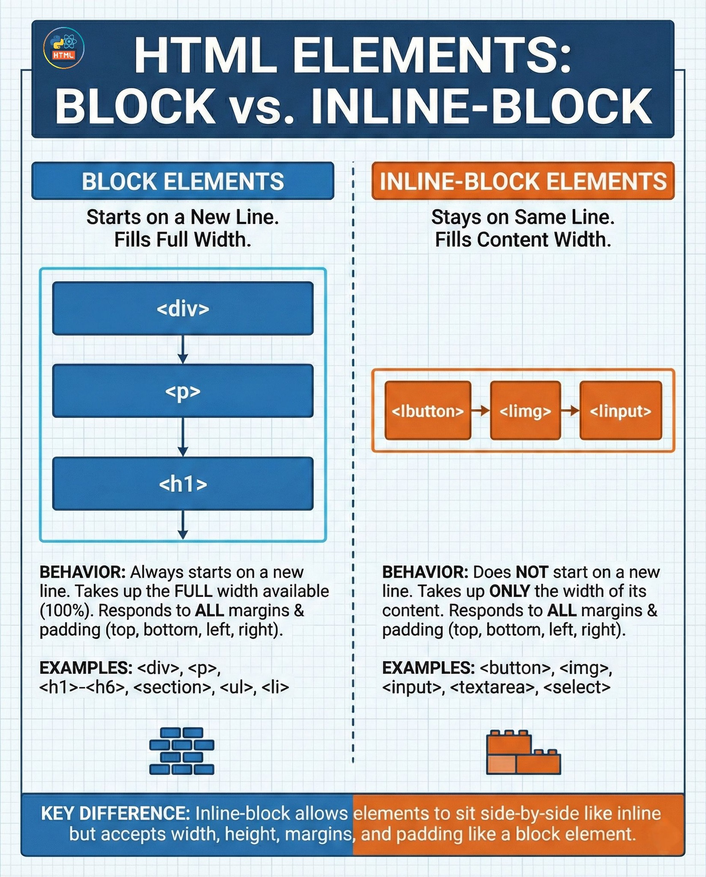

Slide 30


Slide 31
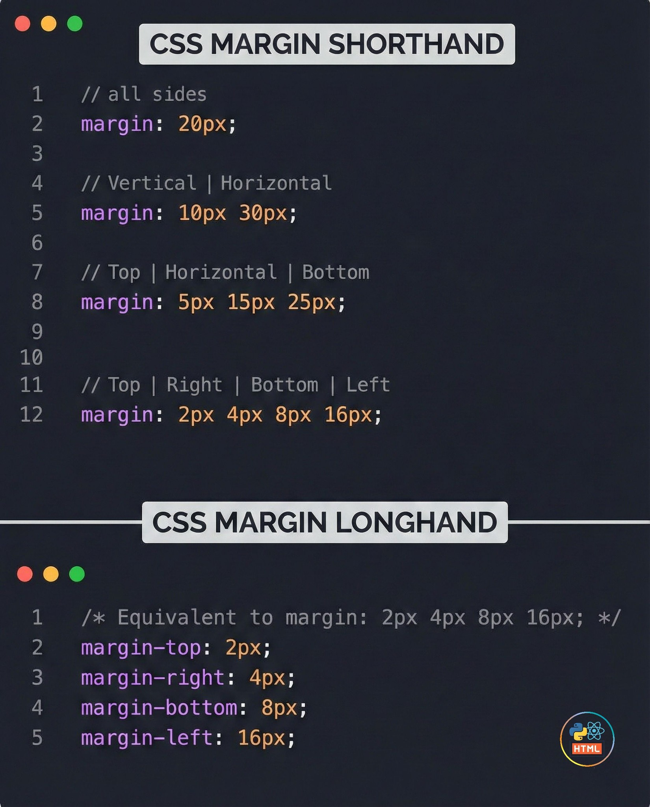
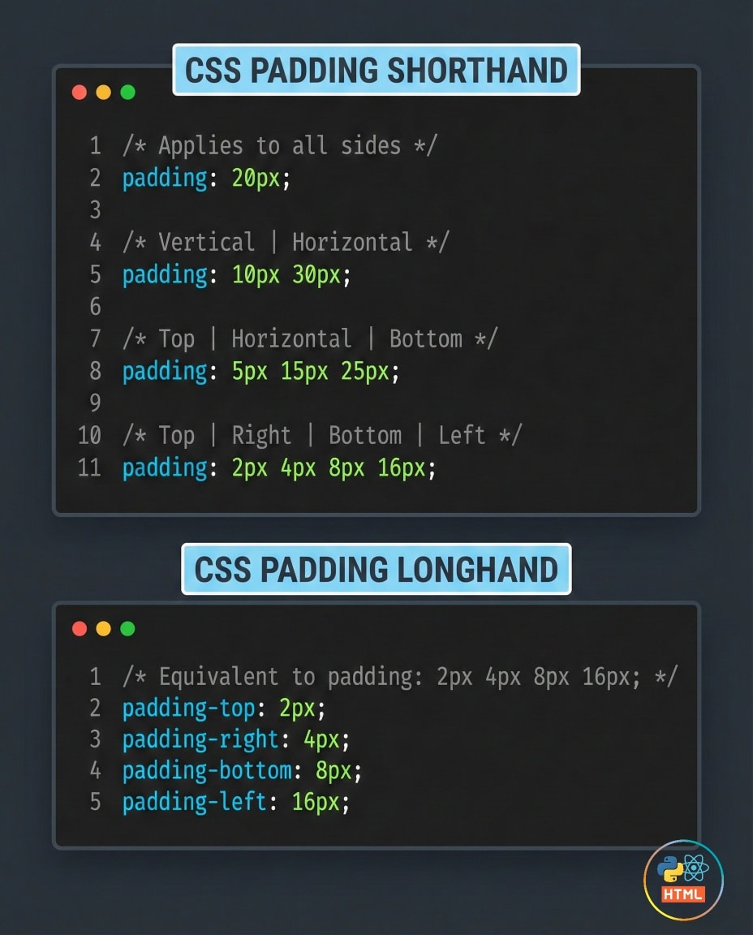

Slide 32
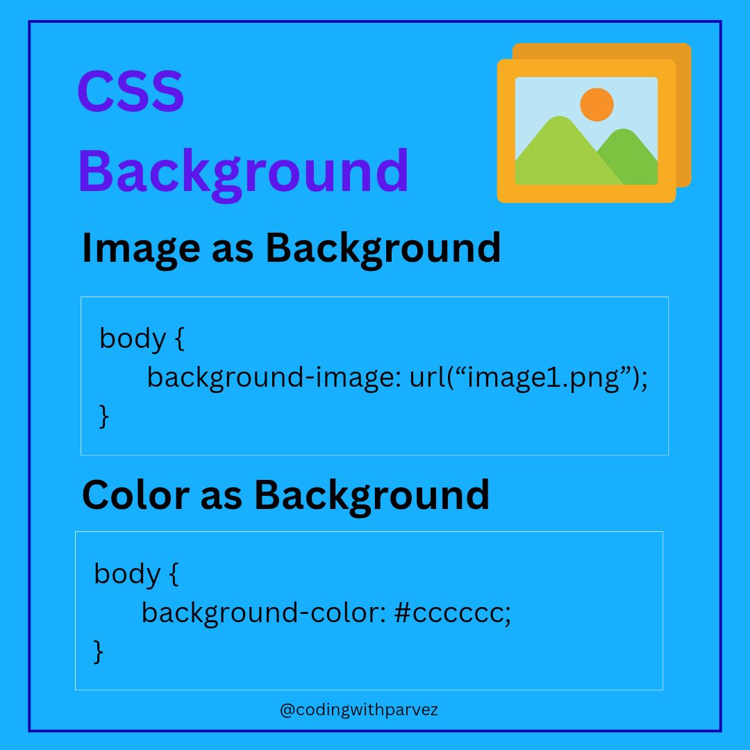

Slide 33
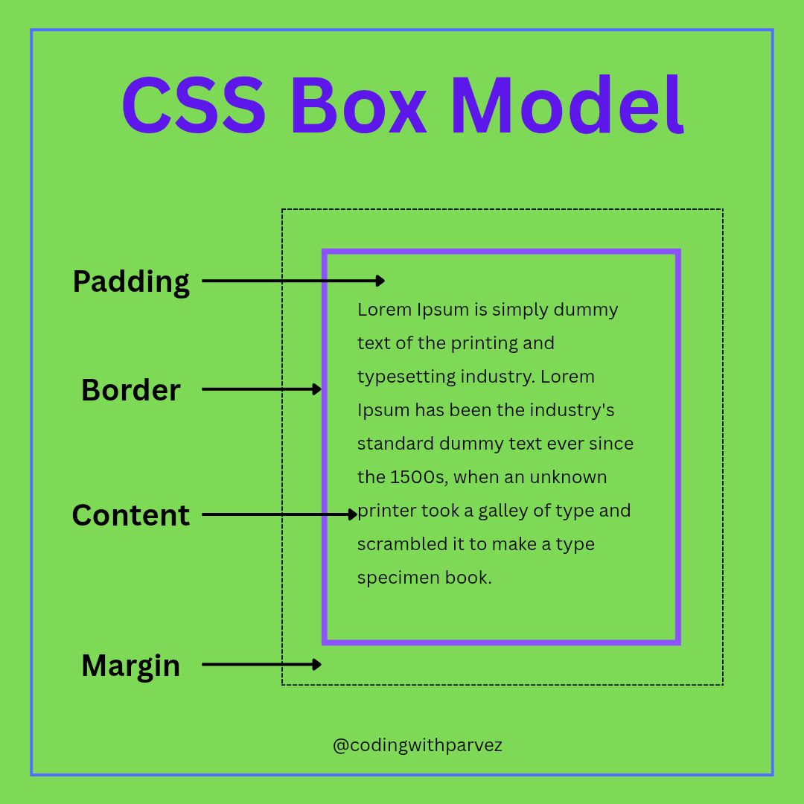
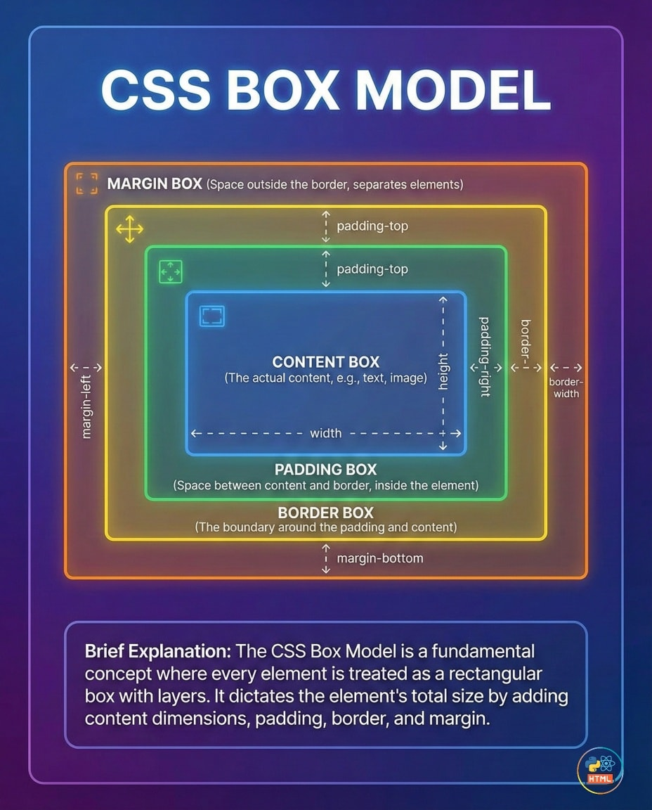

Slide 34
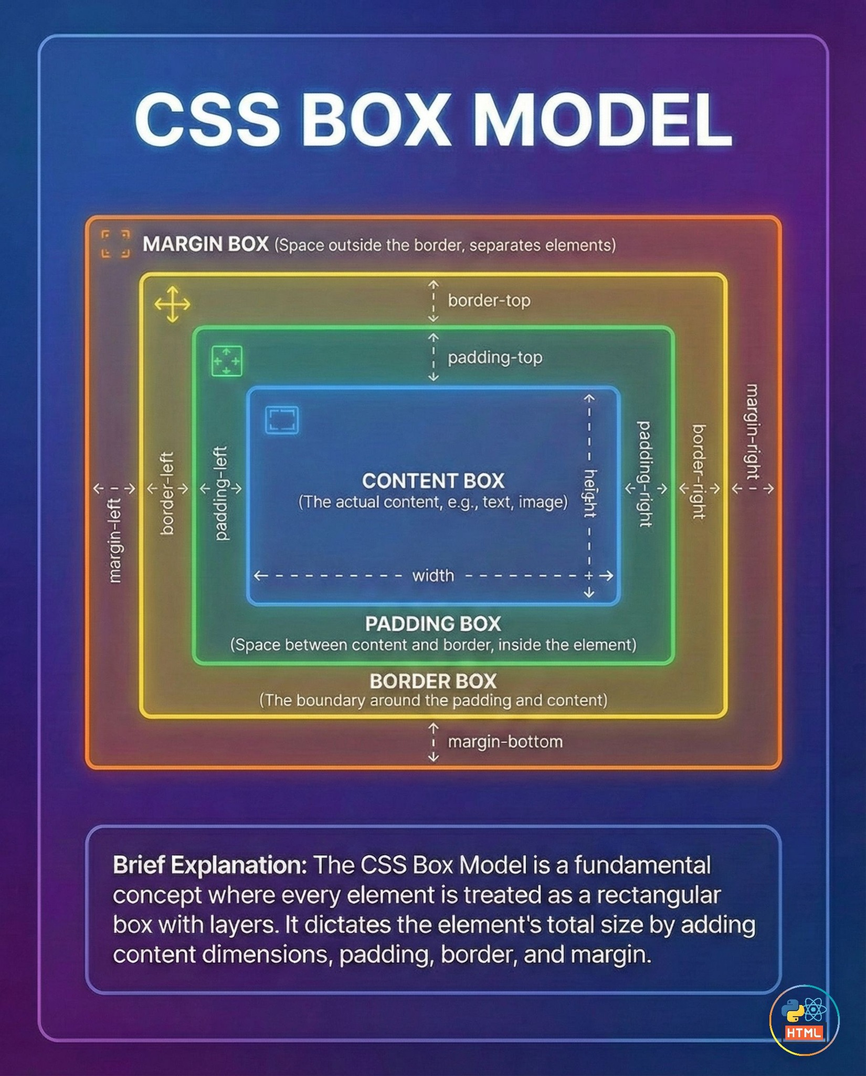

Slide 35
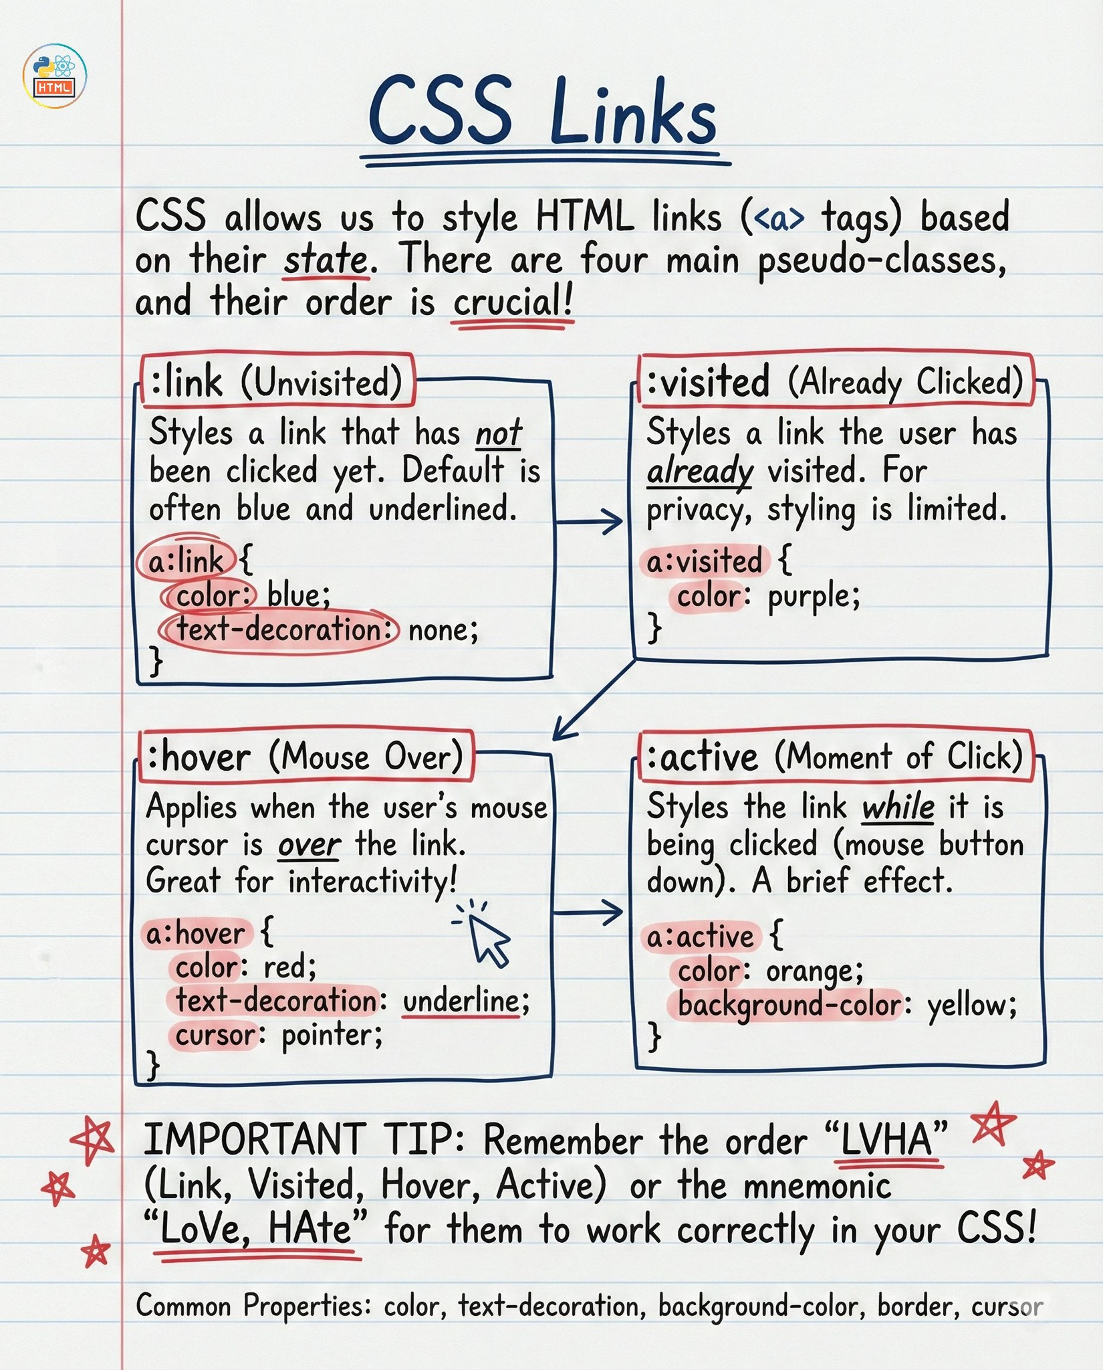

Slide 36
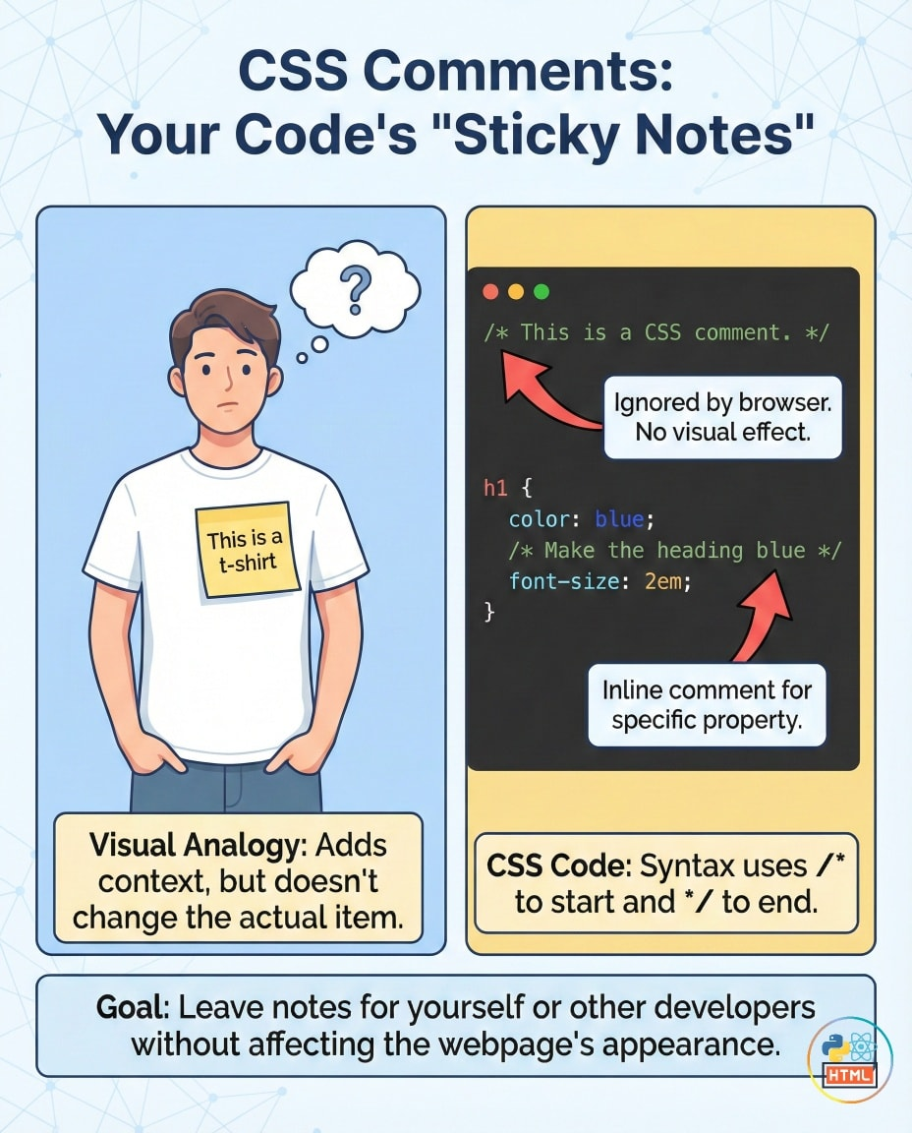
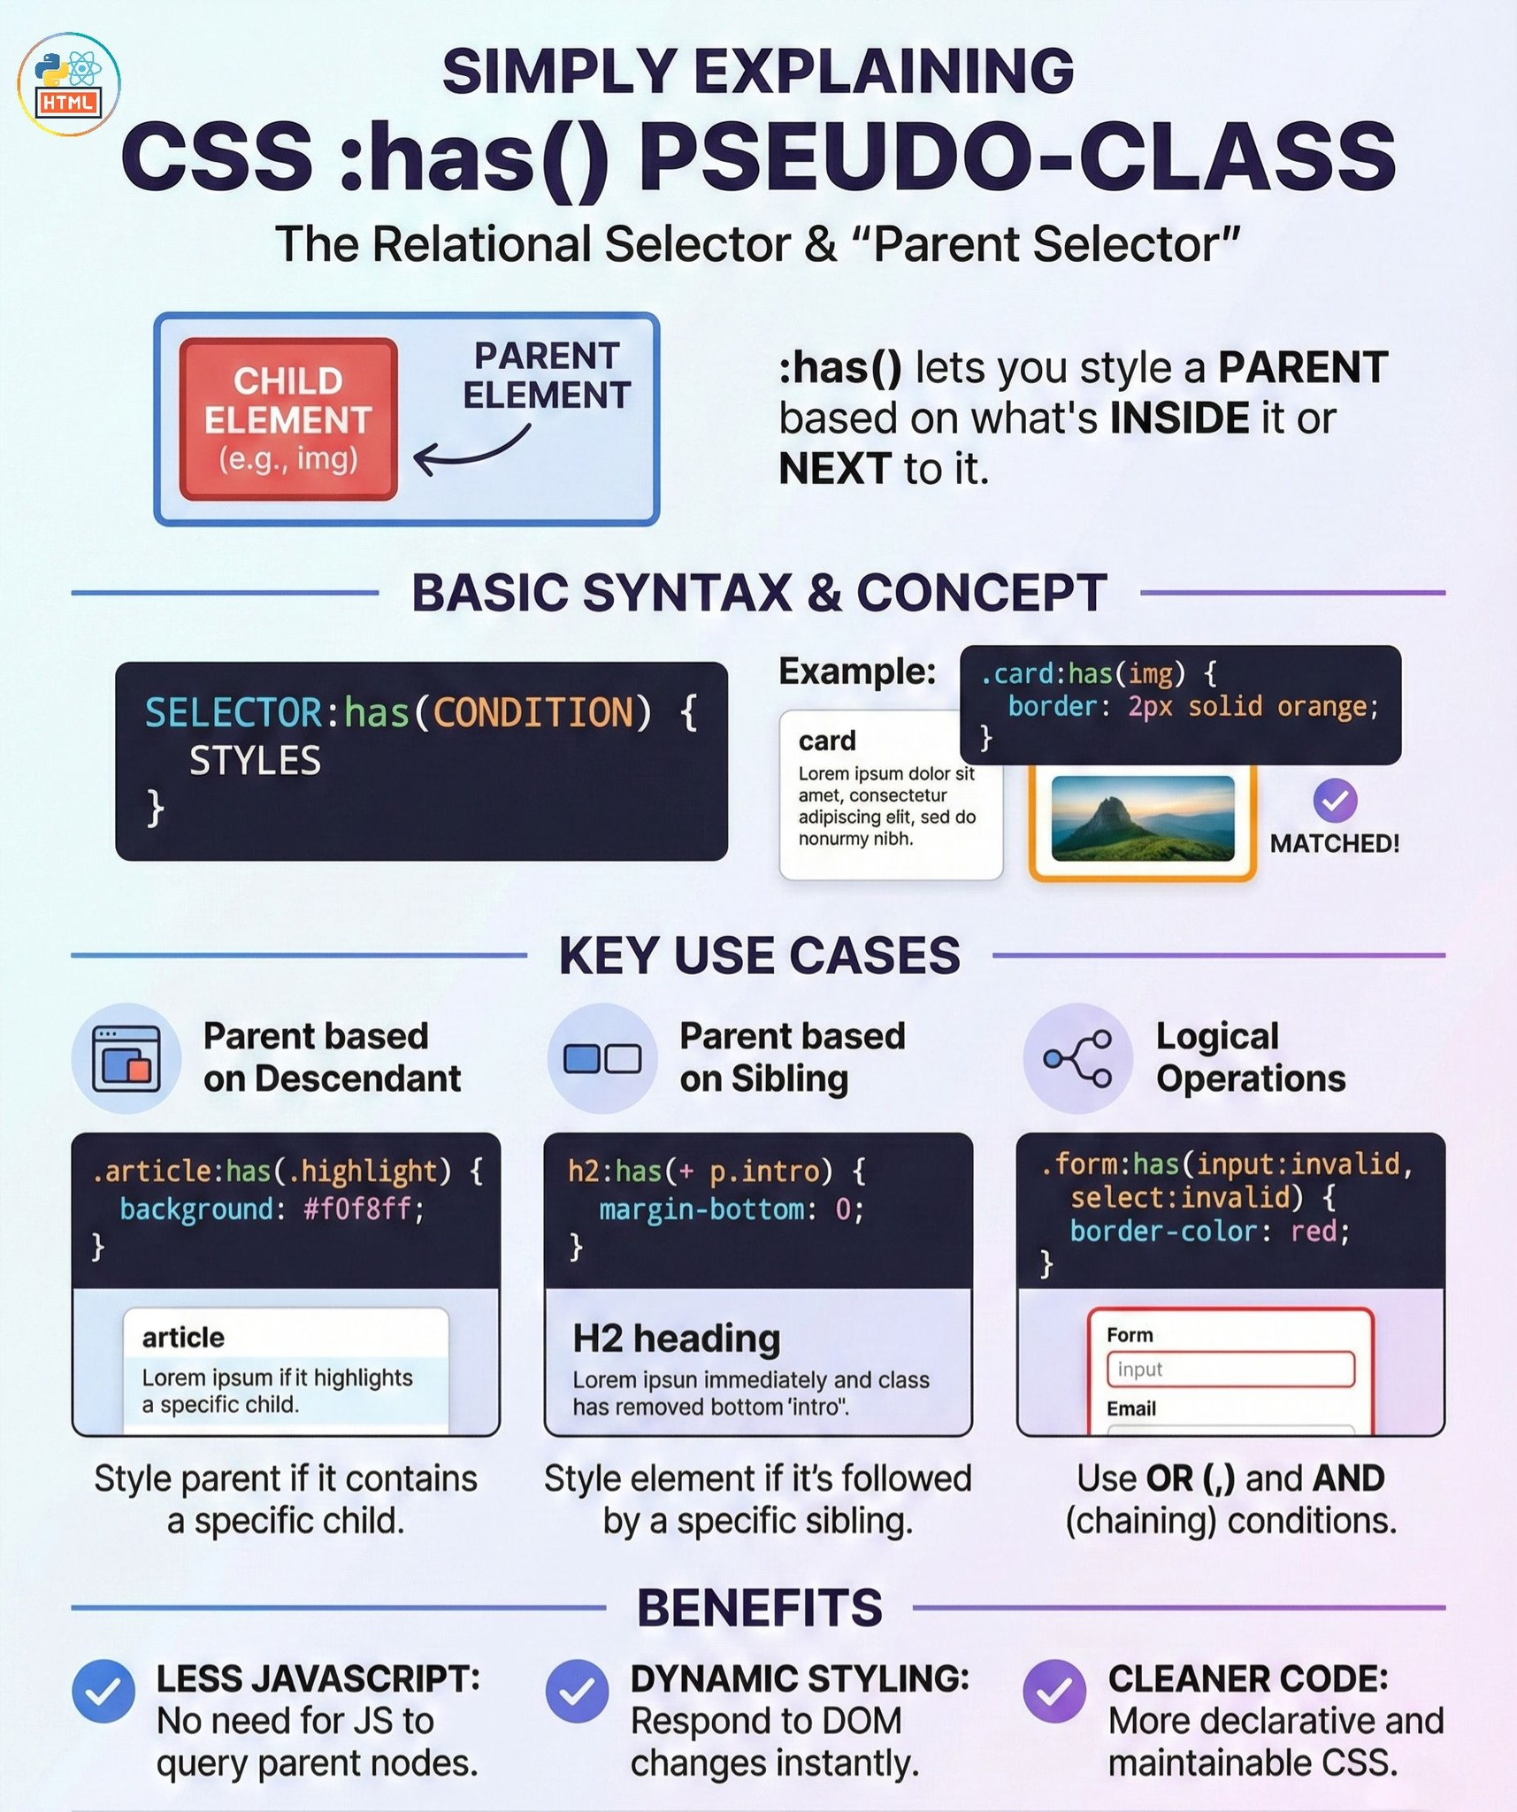

Slide 37
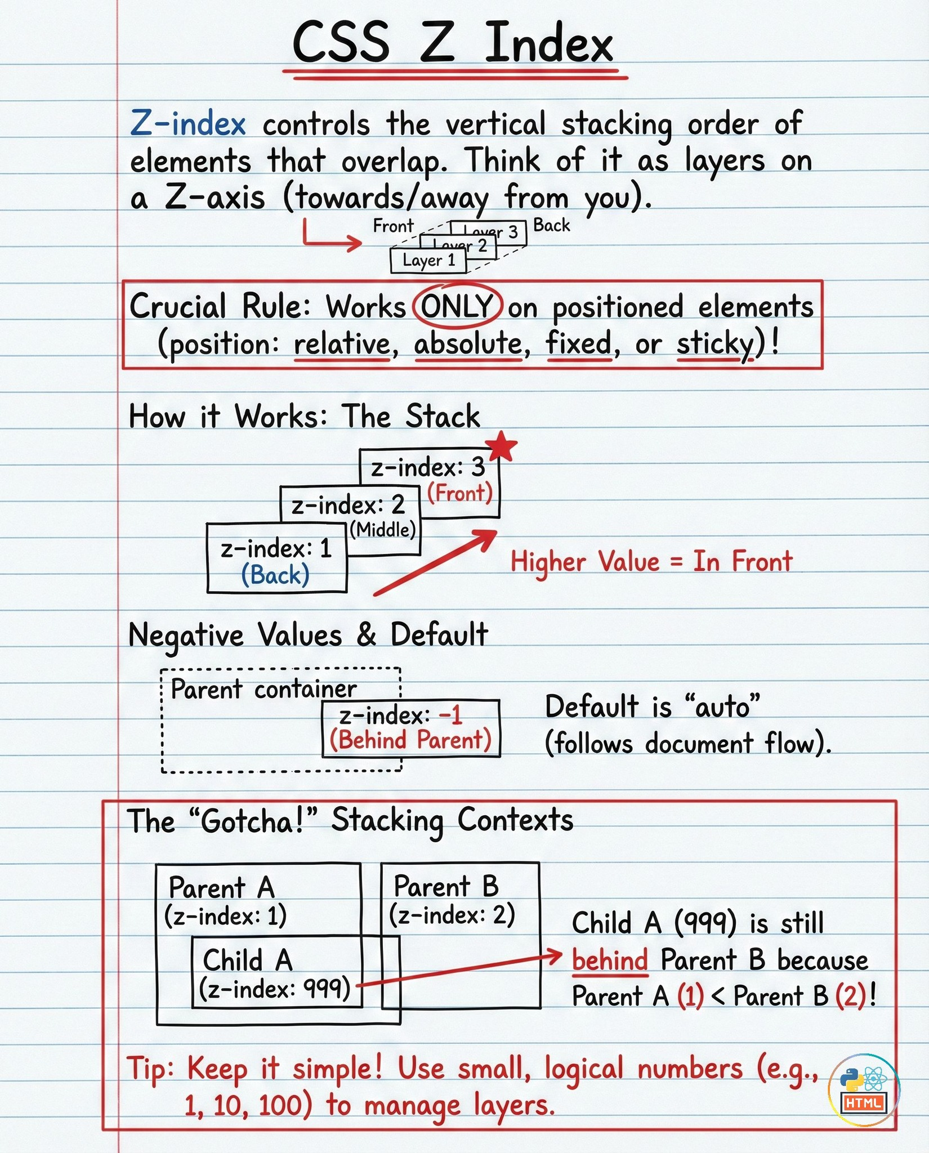
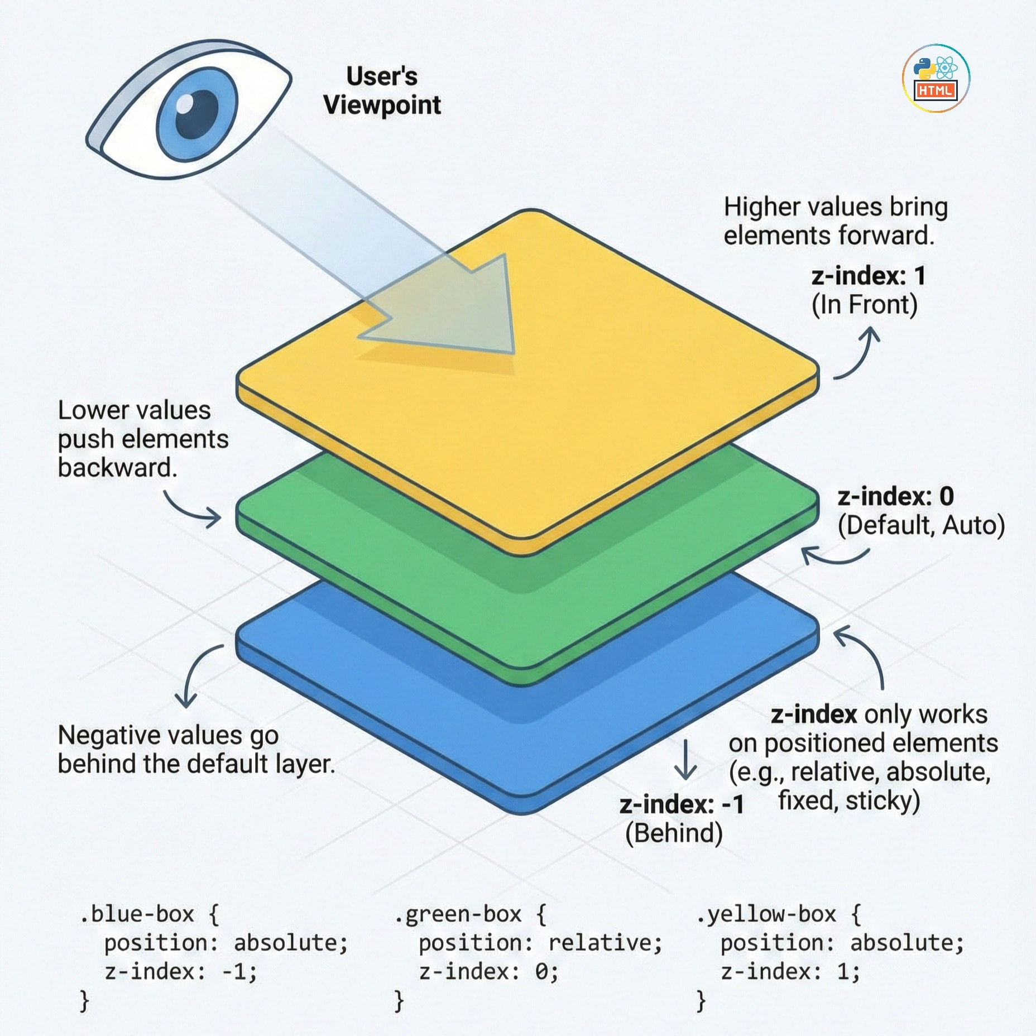

Slide 38
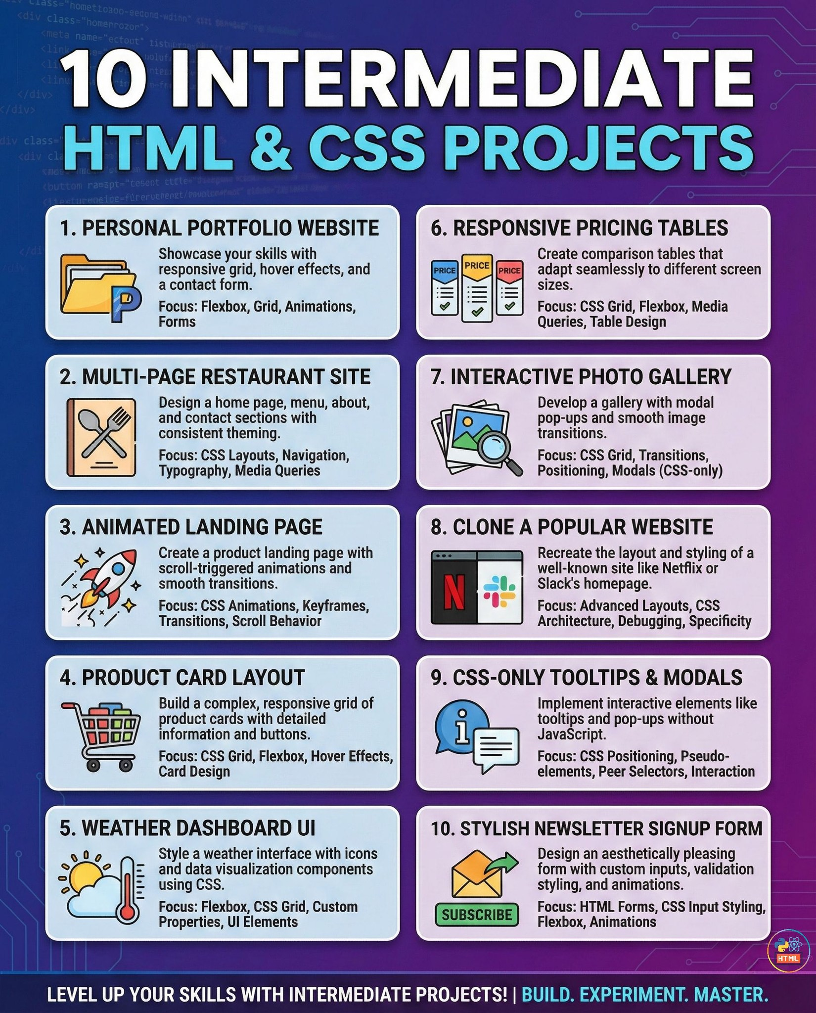
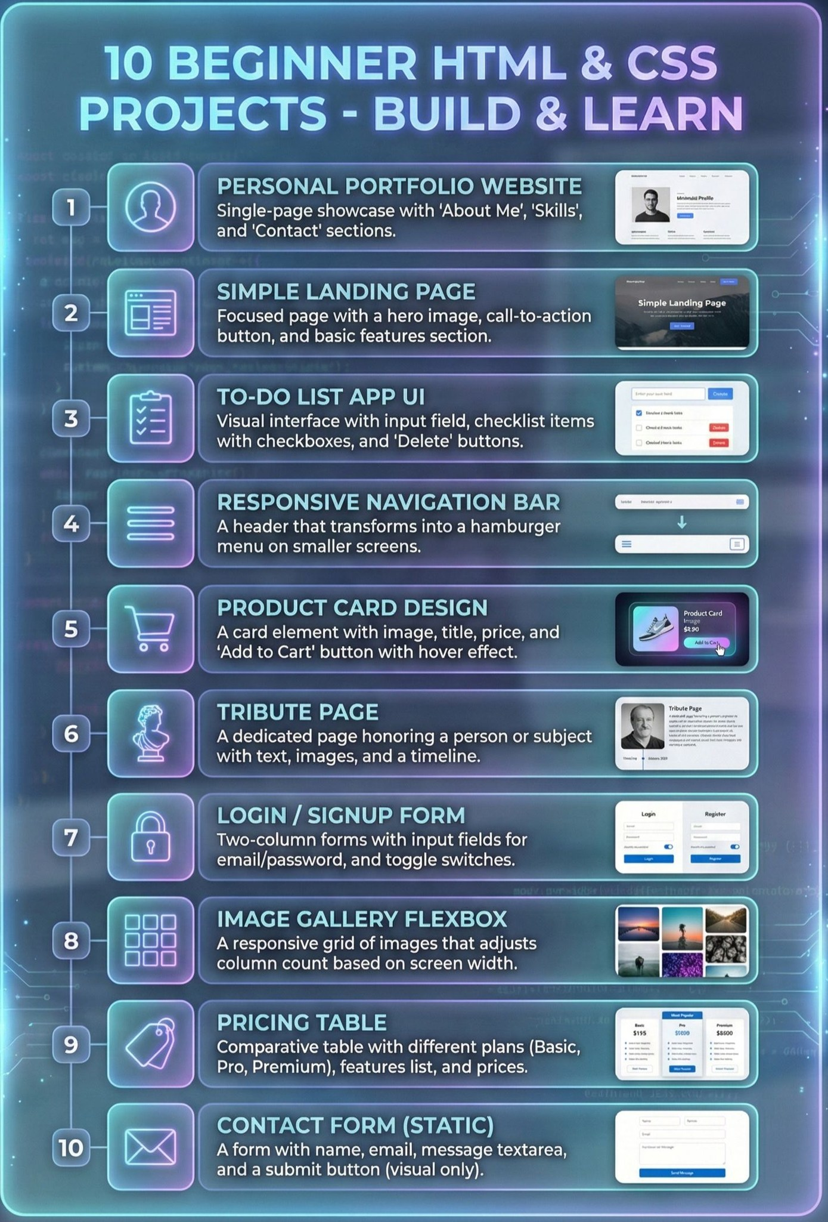

Slide 39
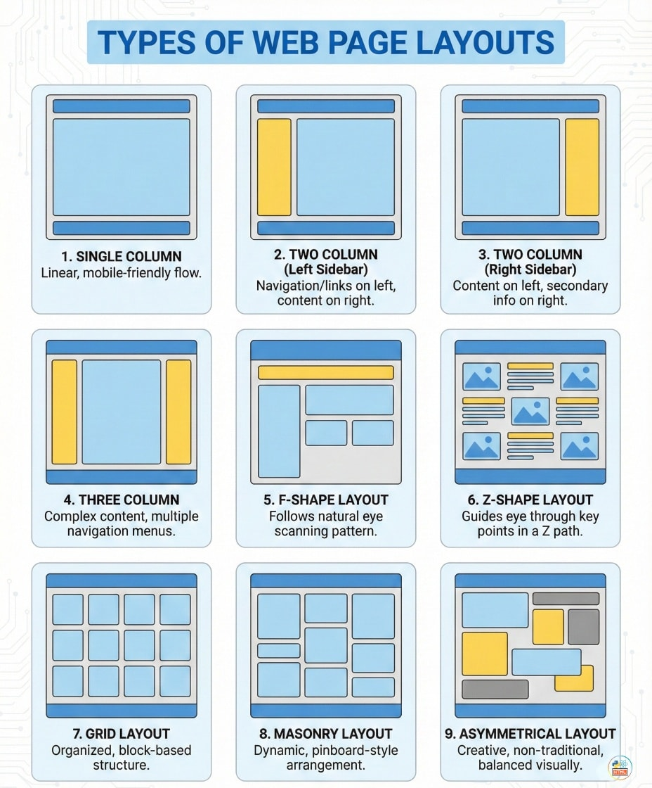

Slide 40


Slide 41
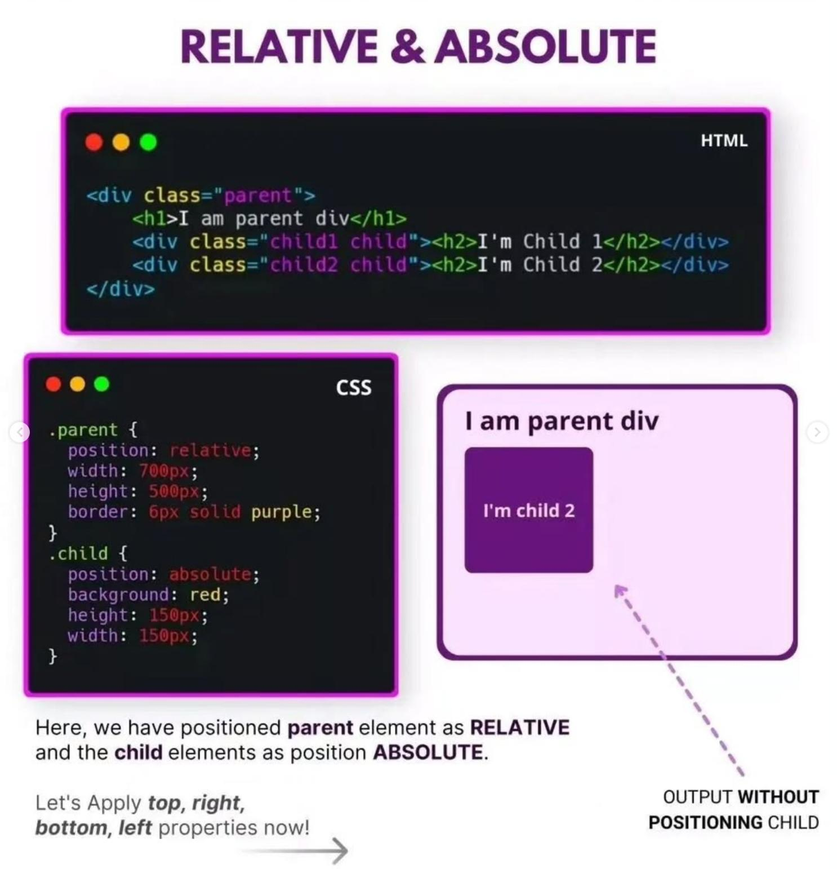

Slide 42
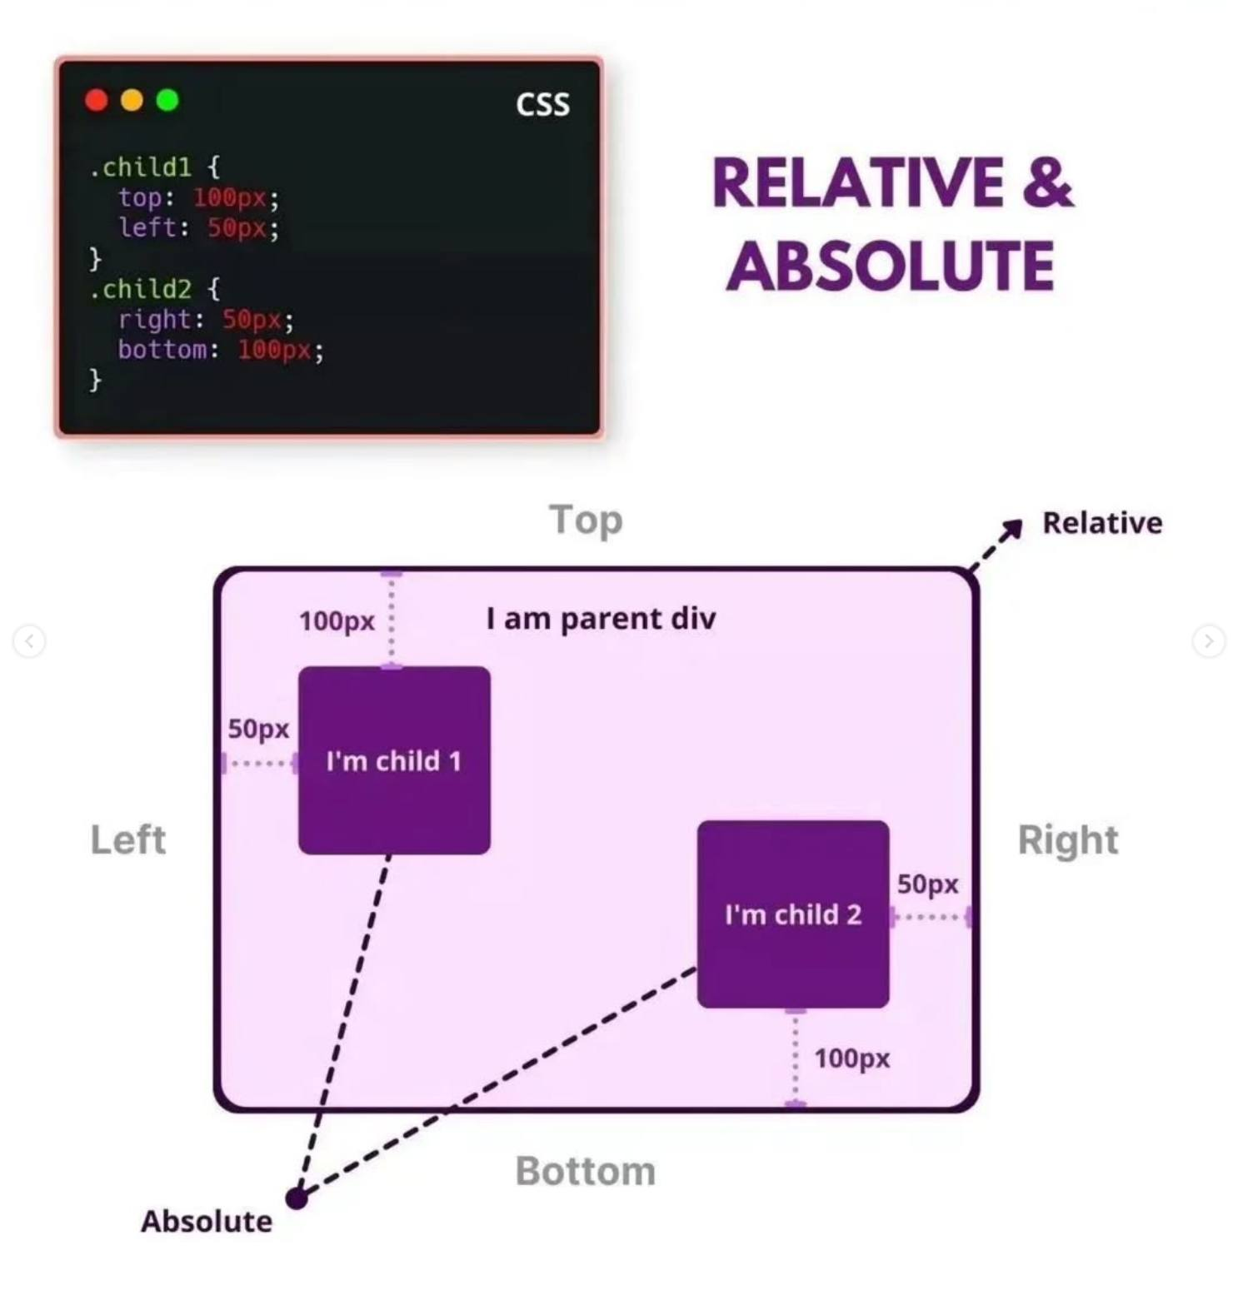

Slide 43
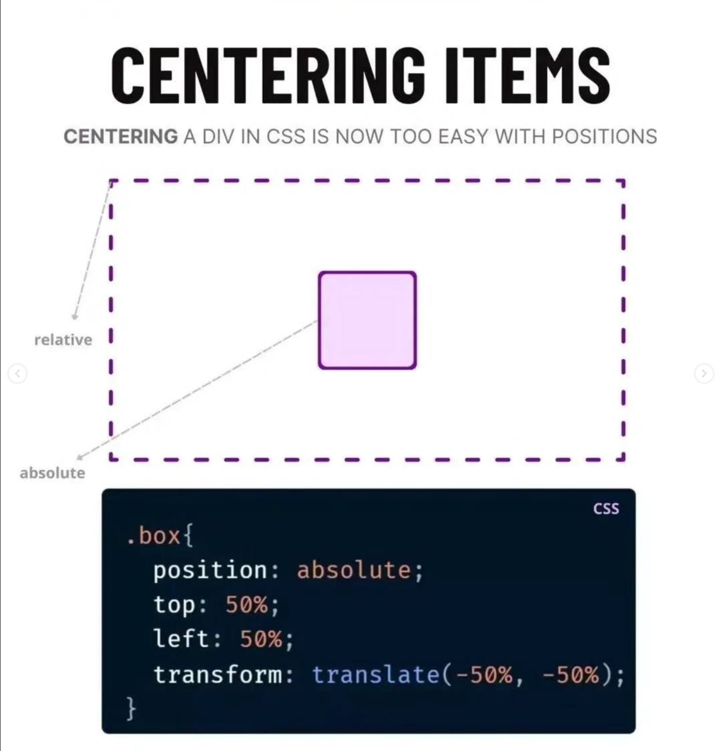

Slide 44
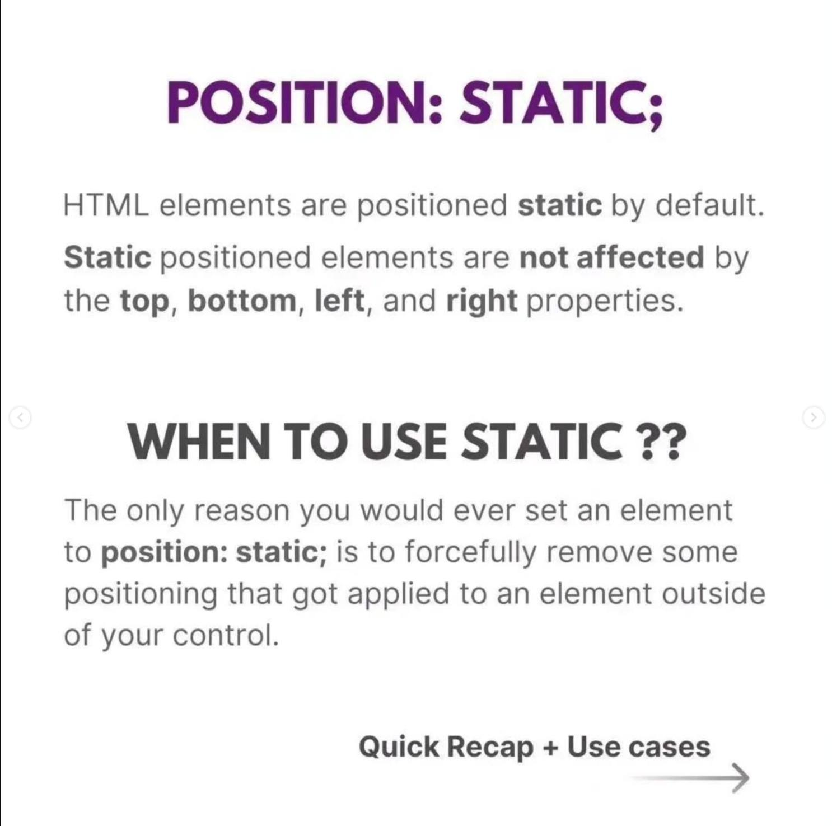

Slide 45
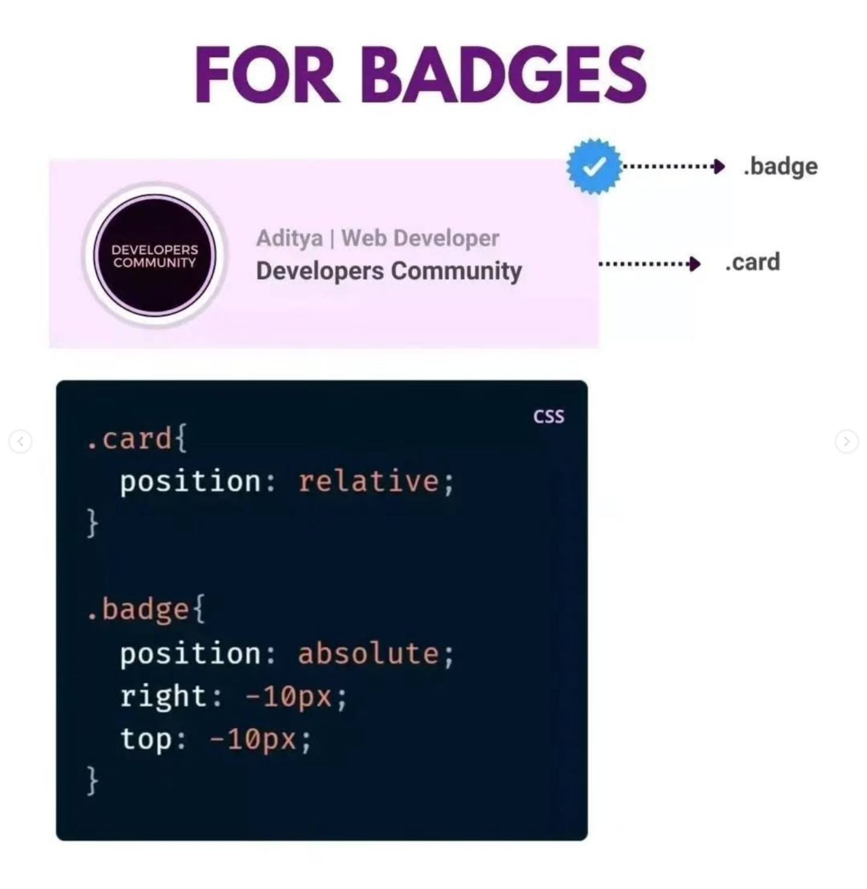

Slide 46
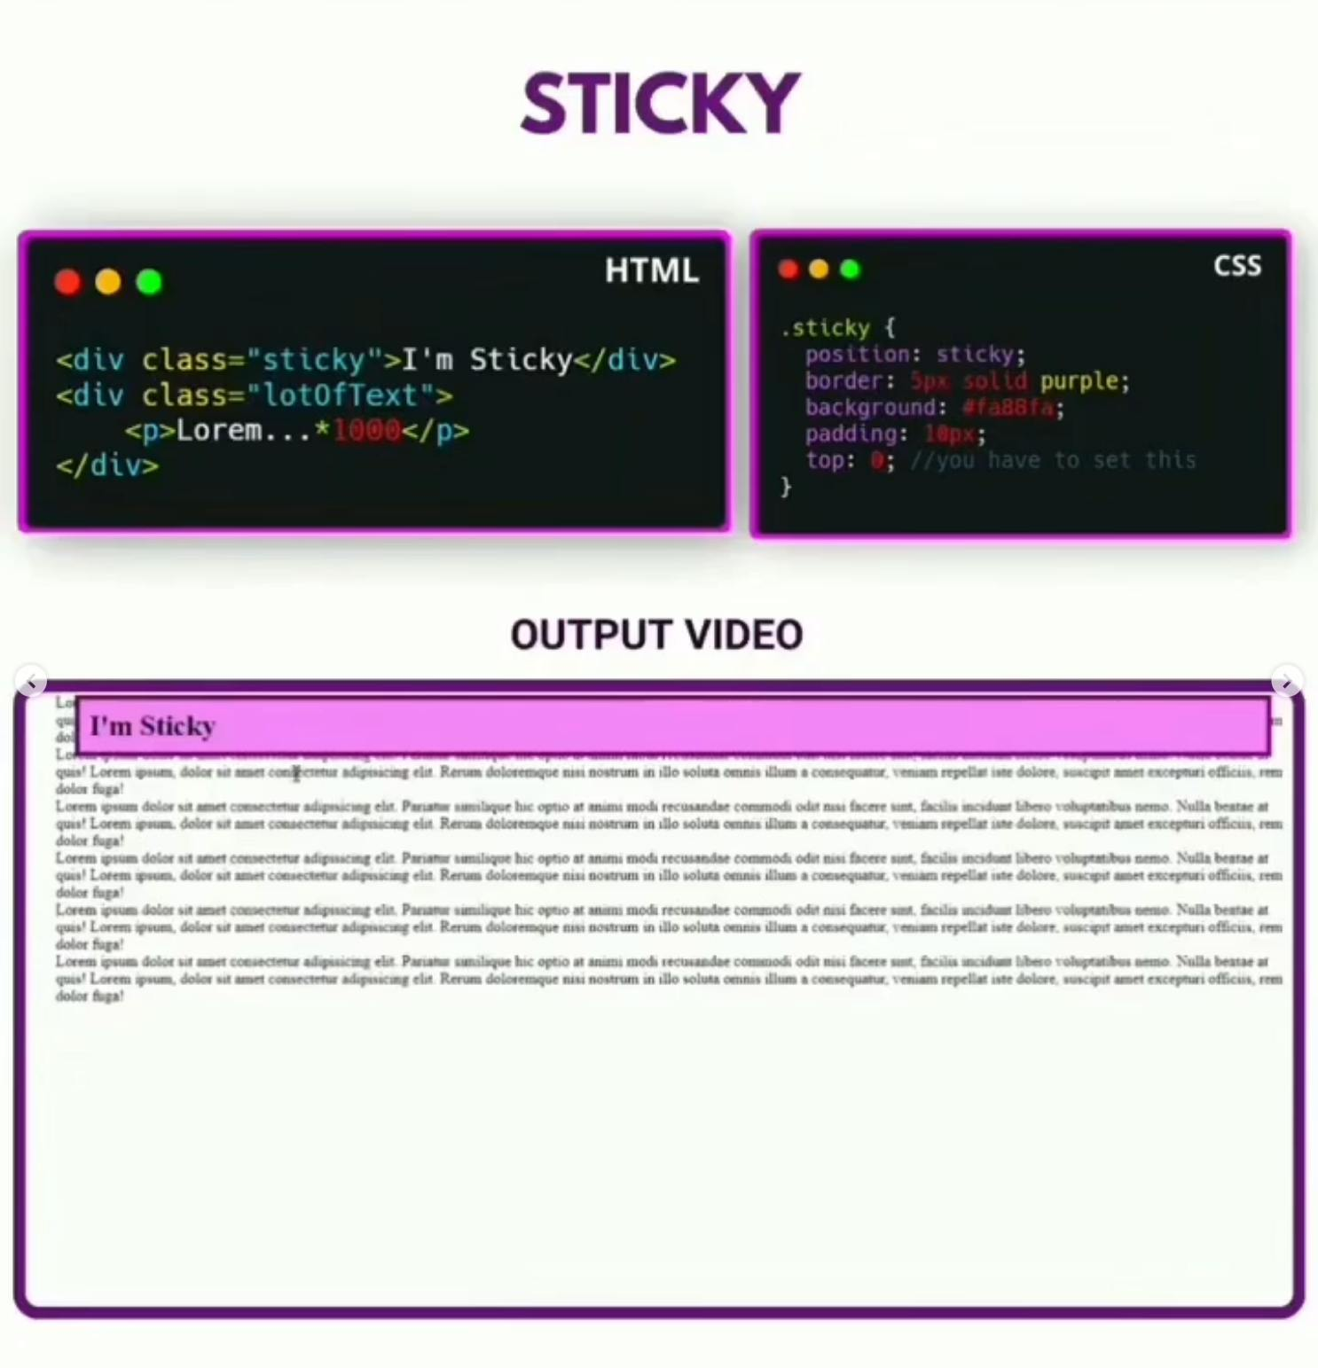

Slide 47


Slide 48


Slide 49


Slide 50


Slide 51


Slide 52


Slide 53


Slide 54


Slide 55


Slide 56


Slide 57


Slide 58


Slide 59


Slide 60


Slide 61


Slide 62


Slide 63


Slide 64


Slide 65


Slide 66


Slide 67


Slide 68



Slide 69



Slide 70



Slide 71



Slide 72


Slide 73



Slide 74



Slide 75



Slide 76



Slide 82


Slide 83


Slide 84


Slide 85


Slide 86


Slide 87


Slide 88


Slide 89


Slide 90


Slide 91


Slide 92


Slide 93


Slide 94


Slide 95


Slide 96


Slide 97



Slide 98



